Slide 1
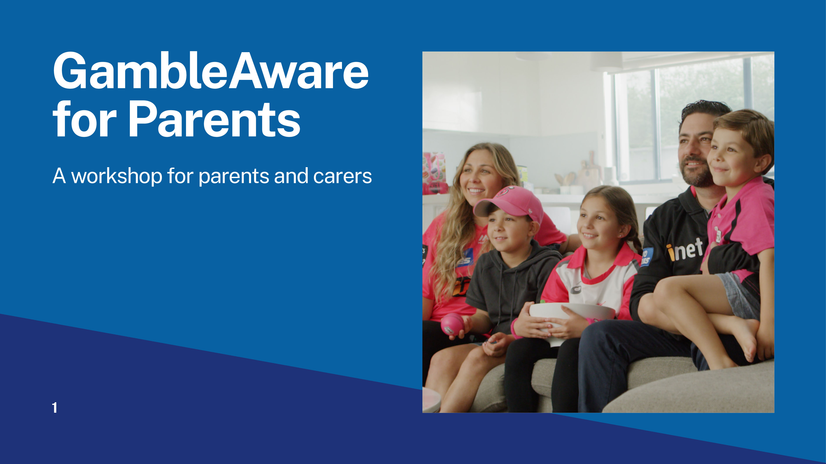
Facilitator’s name and organisation
Notes:
Facilitator's self-introduction: Name, role and organisation
Acknowledgement of Country.
* Please enter facilitator’s name and organisation in the editable text box.

Slide 2
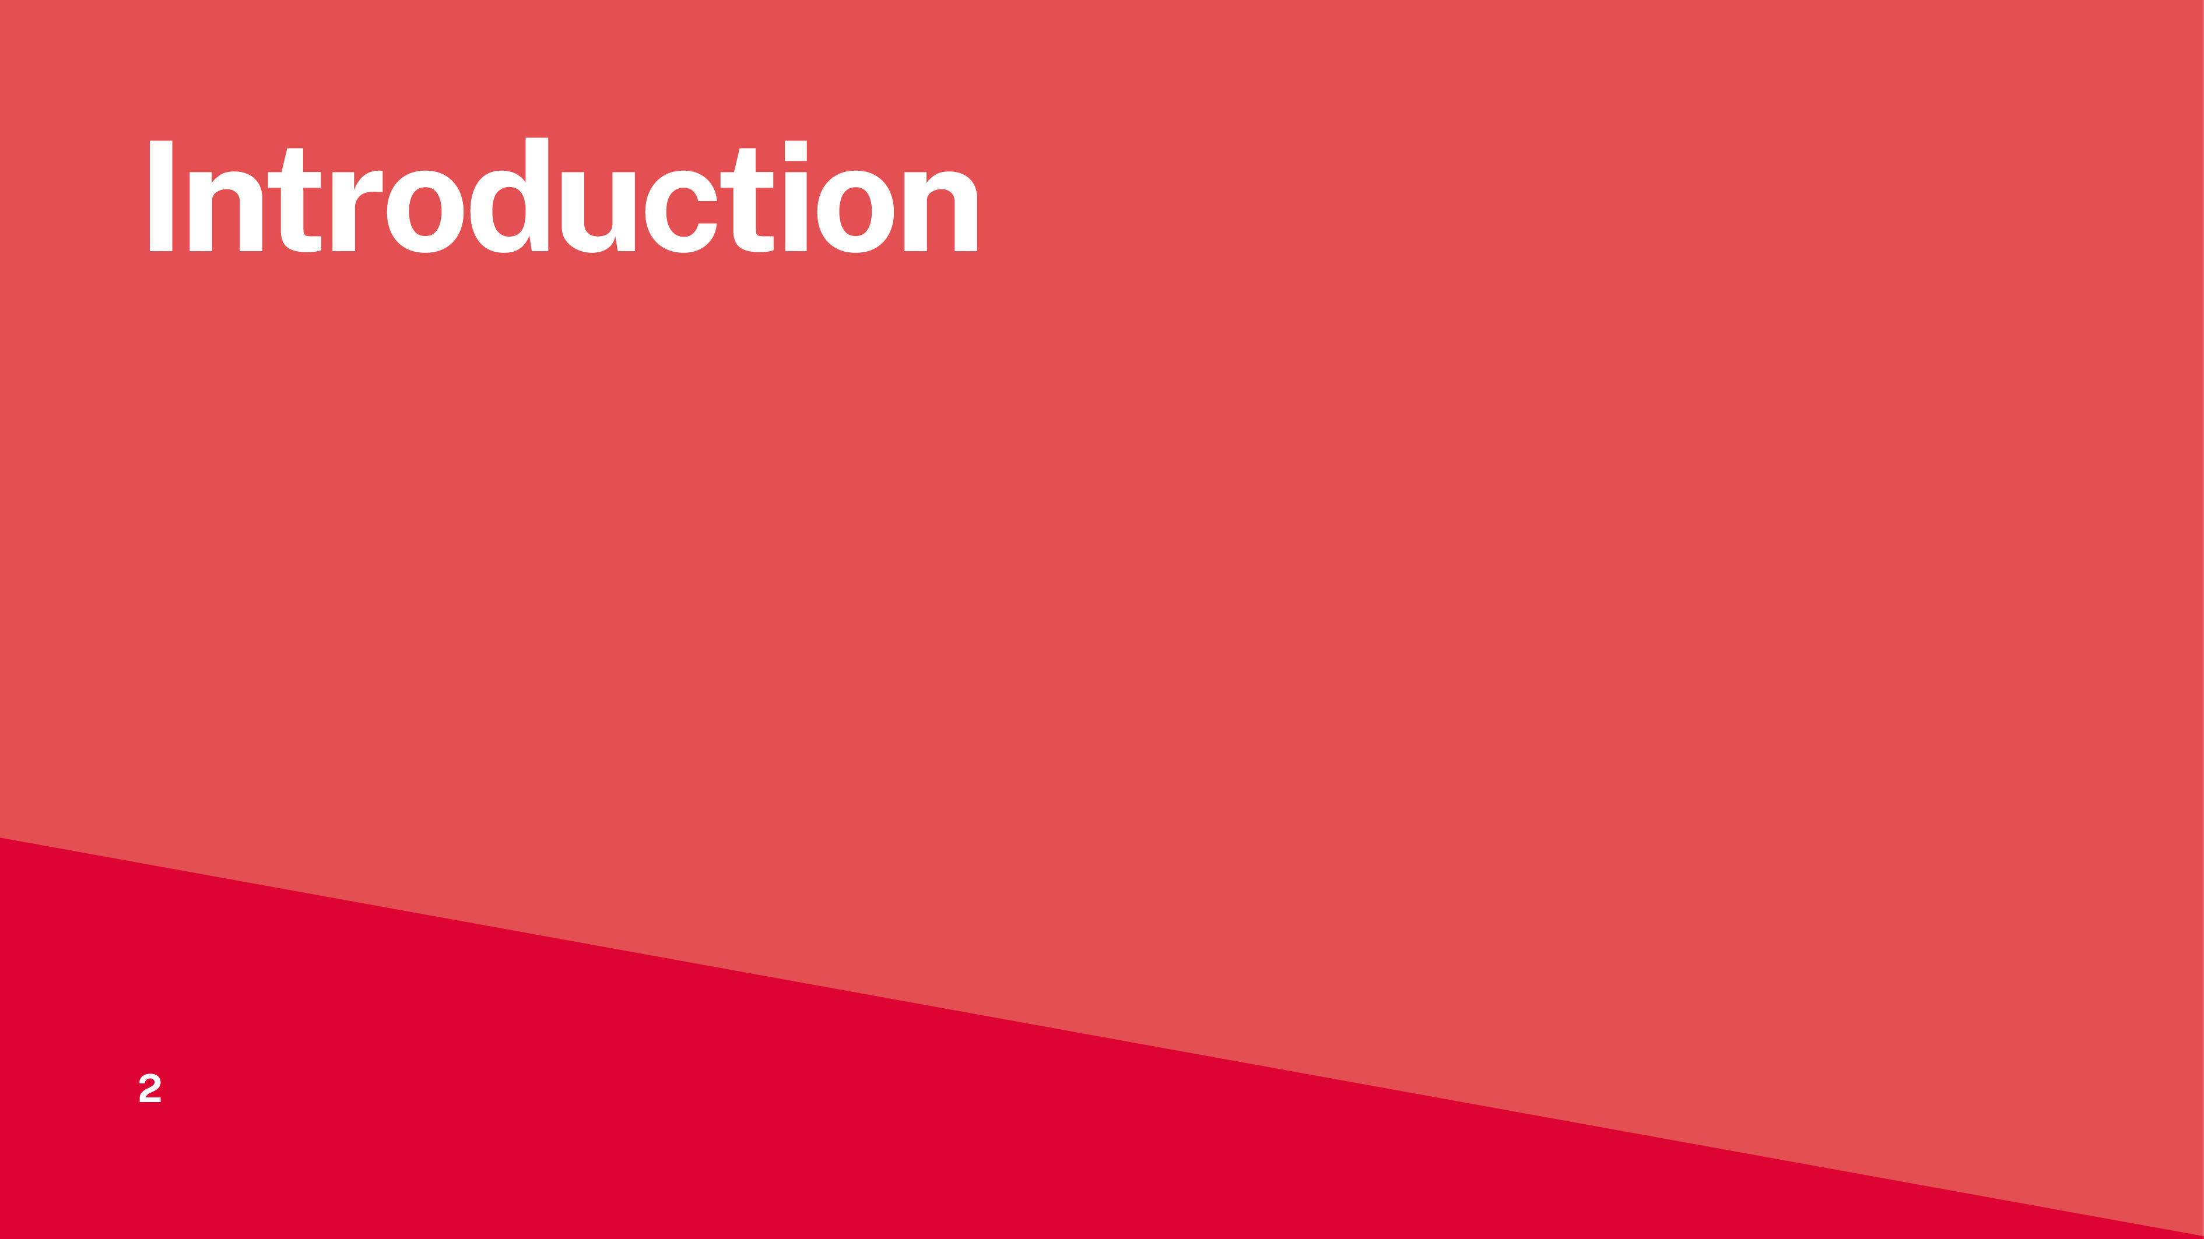
Notes:
Go through general housekeeping.

Slide 3
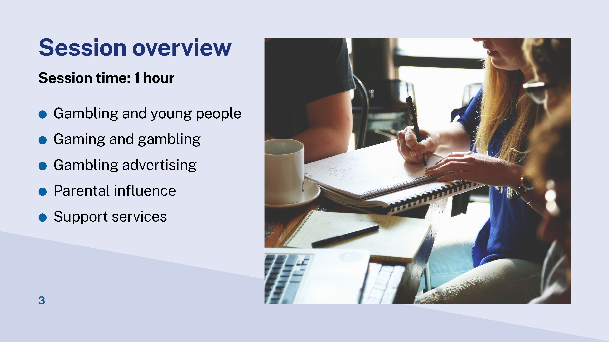
Notes:
This is a one-hour session. There are 10 minutes dedicated time for questions at the end.
Main topics discussed in this session include:
gambling and young people - how young people engage with gambling activities
gaming and gambling - how gaming and gambling are converging
gambling advertising - how gambling advertising affects young people
parental influence - how parents’ gambling attitudes and behaviour affect those of their children
support services - useful services to know for further information or support for parents and young people.

Slide 4
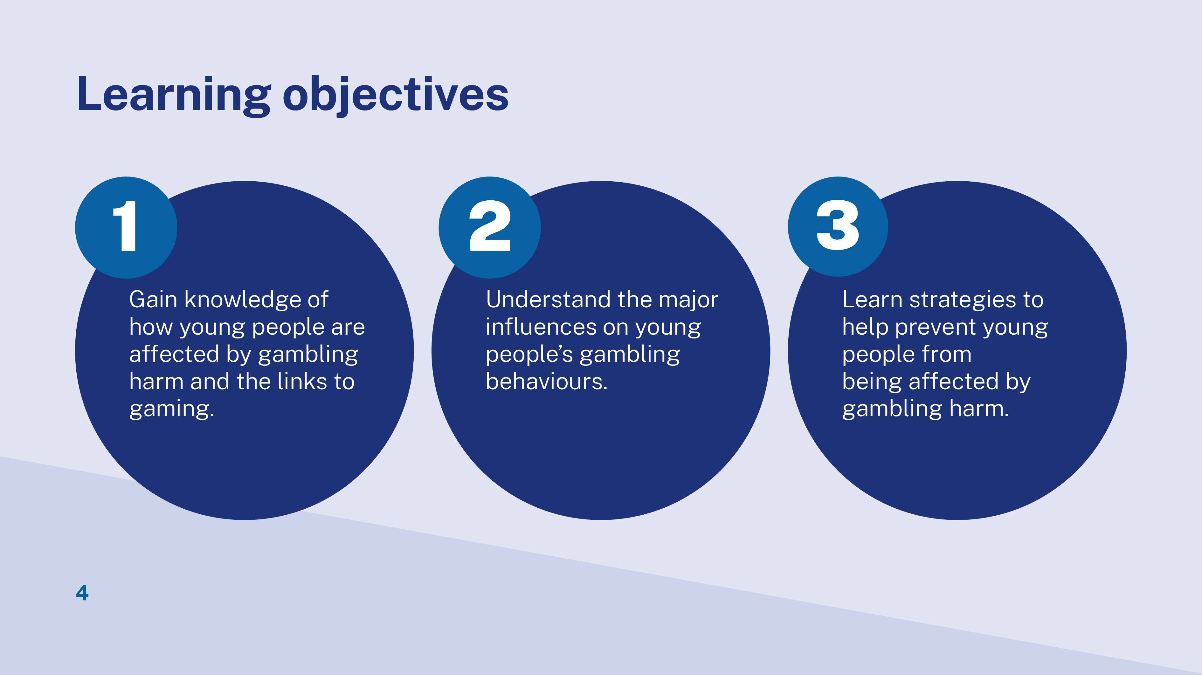
Notes:
We hope by the end of today’s session, you will:
understand how children and young people are affected by gambling
know how parents/carers influence their child’s gambling behaviour
take home some strategies to help your child staying away from gambling harm.

Slide 5
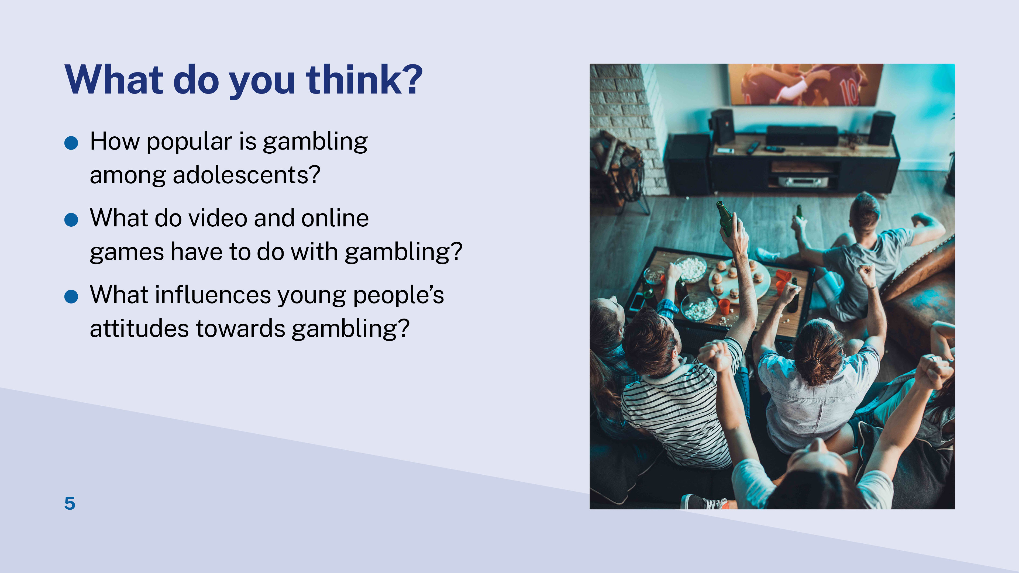
Notes:
Warm up activity
1. Give instruction - Discuss the following questions with the person next to you:
How popular is gambling among adolescents?
Do you think video/on-line games have anything to do with gambling?
What influences young people’s attitude towards gambling?
2. Ask a couple of volunteers from the participants to share response to each question.
If it is an online session, participants will think about these questions individually. You can then ask them to share answers with the group via chat function in virtual meeting rooms.

Slide 6
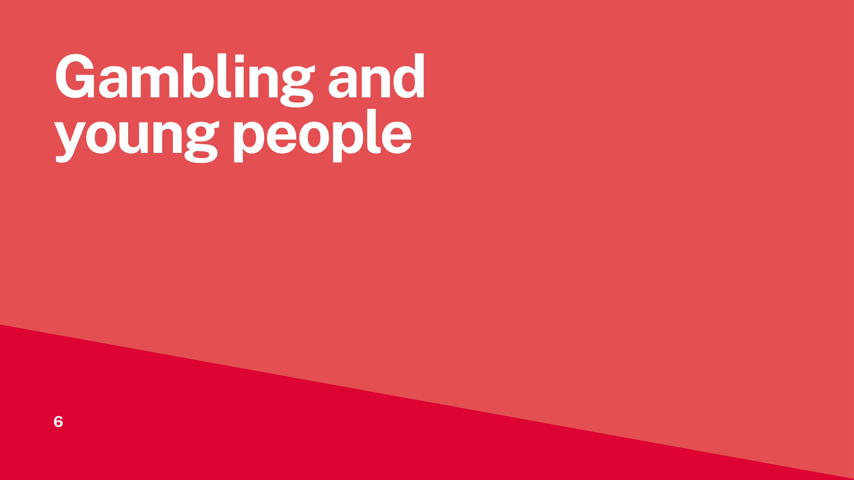
Notes:
This section aims to give participants a general idea about how young people (aged 12-17) in NSW engage with gambling.
Information for this section is from the NSW Youth Gambling Study 2020.
This study was commissioned by the Office of Responsible Gambling and conducted by Central Queensland University.

Slide 7
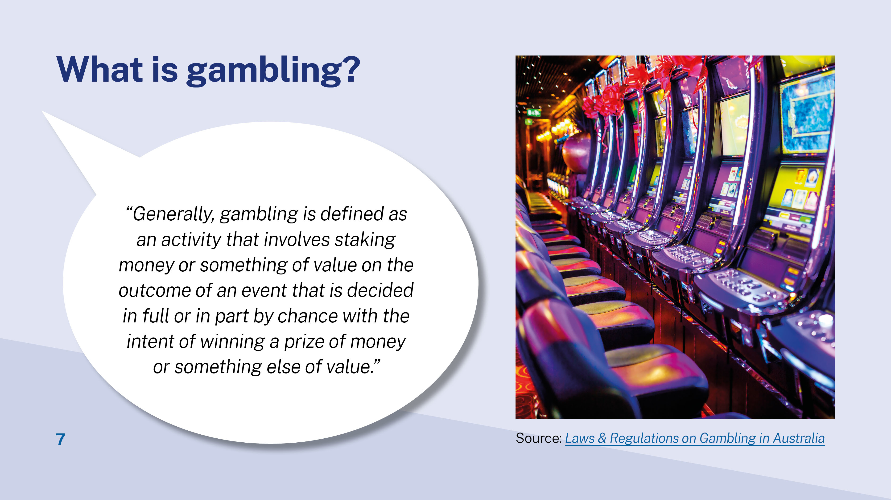
Notes:
Read out the quoted definition. It is based on many versions of legal definitions of gambling in Australia.
2. Point out key elements of gambling include:
risks money or belongings
randomness or chance involved
the purpose is to win.
3. Clarify that this definition captures the activities considered as gambling by Liquor & Gaming NSW, such as poker machines (pokies), casino games, betting on sports and races, lotteries, and online wagering.

Slide 8
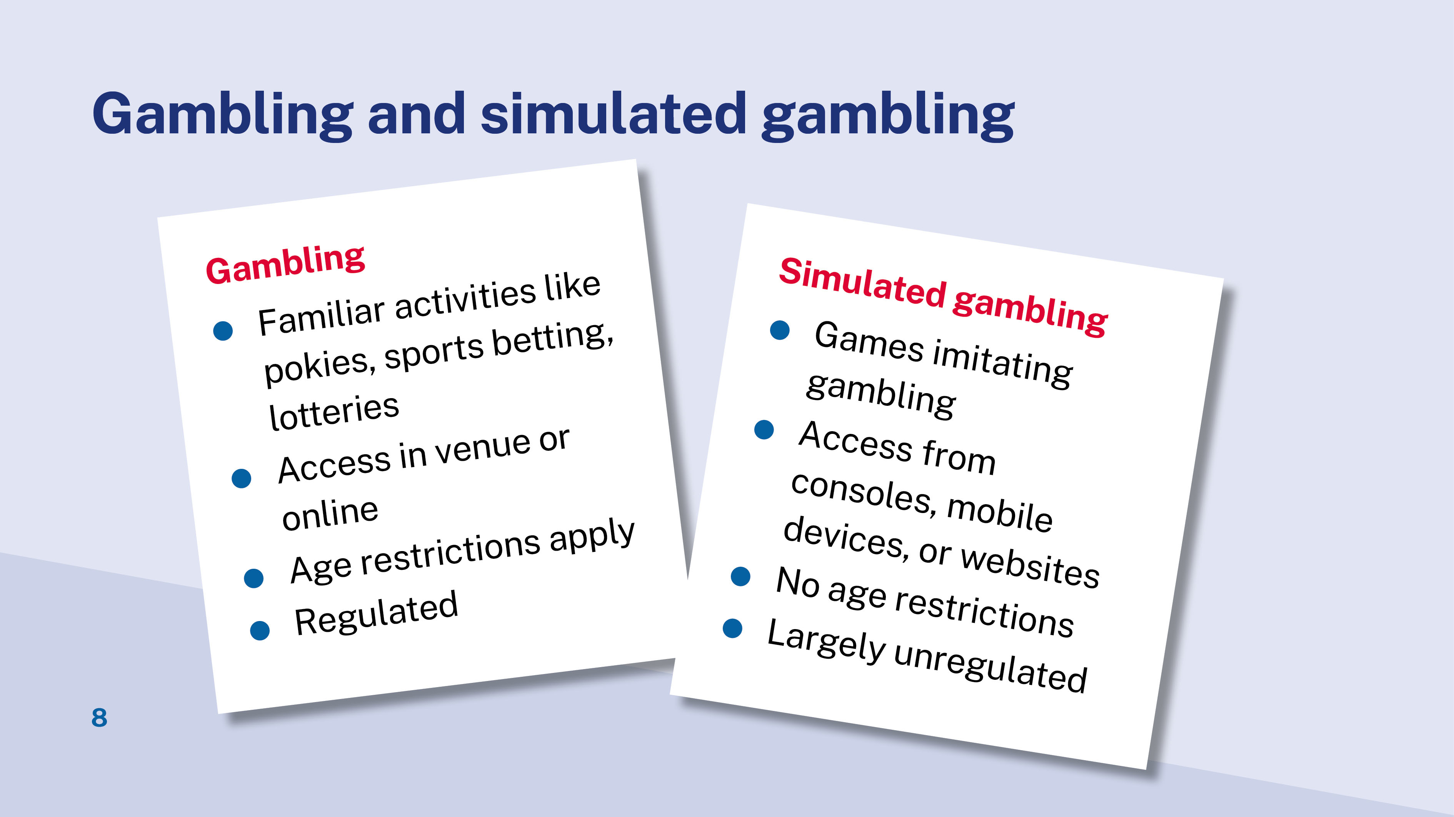
Notes:
1. Introduce the concept of simulated gambling. Simulated gambling referrers to games mimicking the characteristics of traditional gambling but not providing an opportunity to stake, win or lose real-world money.
Popular forms of simulated gambling are:
games of poker, lotteries and casino-style
mini gambling games included within bigger non-gambling games
games having elements associated with gambling.
2. Comparison of gambling and simulated gambling is presented in the table.
More detailed information about simulated gambling is discussed in the next topic - Gaming and gambling.

Slide 9
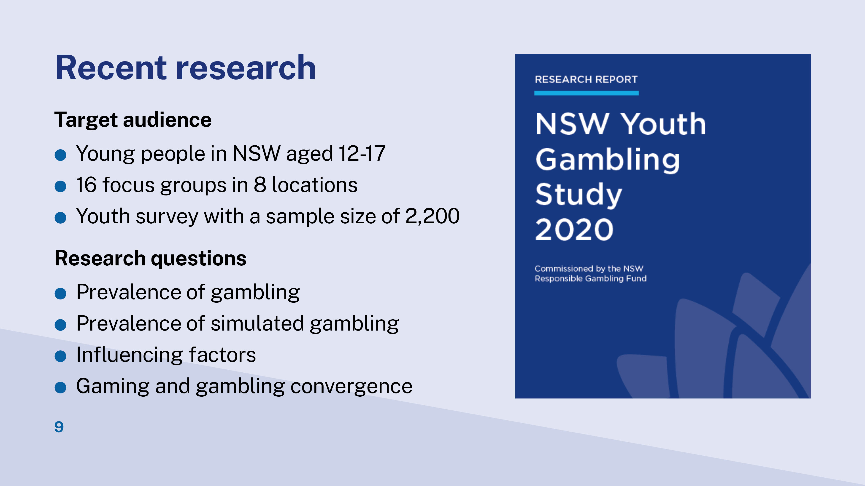
Notes:
This slide presents background information about the NSW Youth Gambling Study 2020.
The study is designed of two empirical stages:
Stage 1 conducted in September 2019
Method: Interviews with 16 focus groups with 104 participants held in eight diverse locations, including two with Indigenous participants and one each with Chinese and Vietnamese participants.
Stage 2 conducted from 28 March to 11 May 2020
Method: Online survey with 2,220 young people recruited via flyers delivered to household letterboxes, a Qualtrics panel and email/online advertising.
This study provides insight of gambling and simulated gambling by young people aged 12-17 years in NSW.

Slide 10
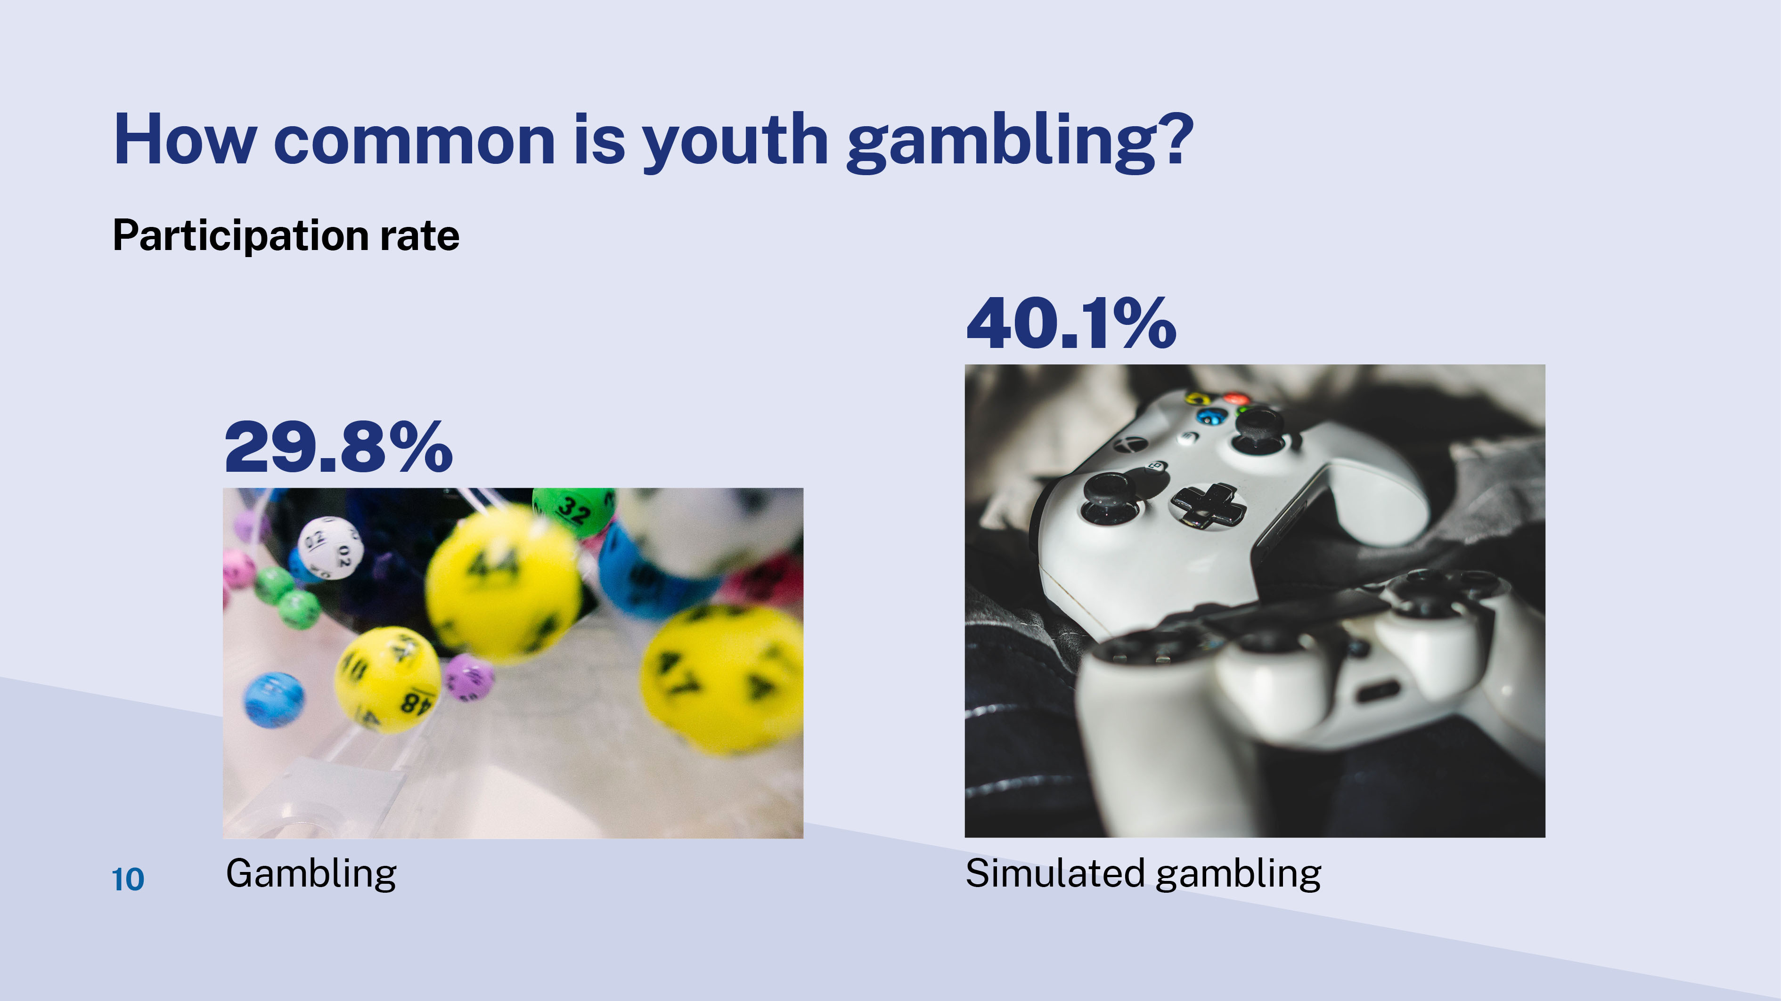
Notes:
Key findings about youth gambling prevalence in NSW in the past 12 month period at the time of the survey:
29.8% had participated in monetary gambling and 40.1% had played games with gambling components.
The most popular gambling activities were: private betting (17.1%), scratchies/lotteries (11%), bingo (6%) and keno (5.1%).
40.1% played at least one type of simulated gambling game.
Video games with ‘mini’ gambling components were the most played (31.7% ).
The most played simulated gambling components were wheel spinning, pokies and casino games.

Slide 11
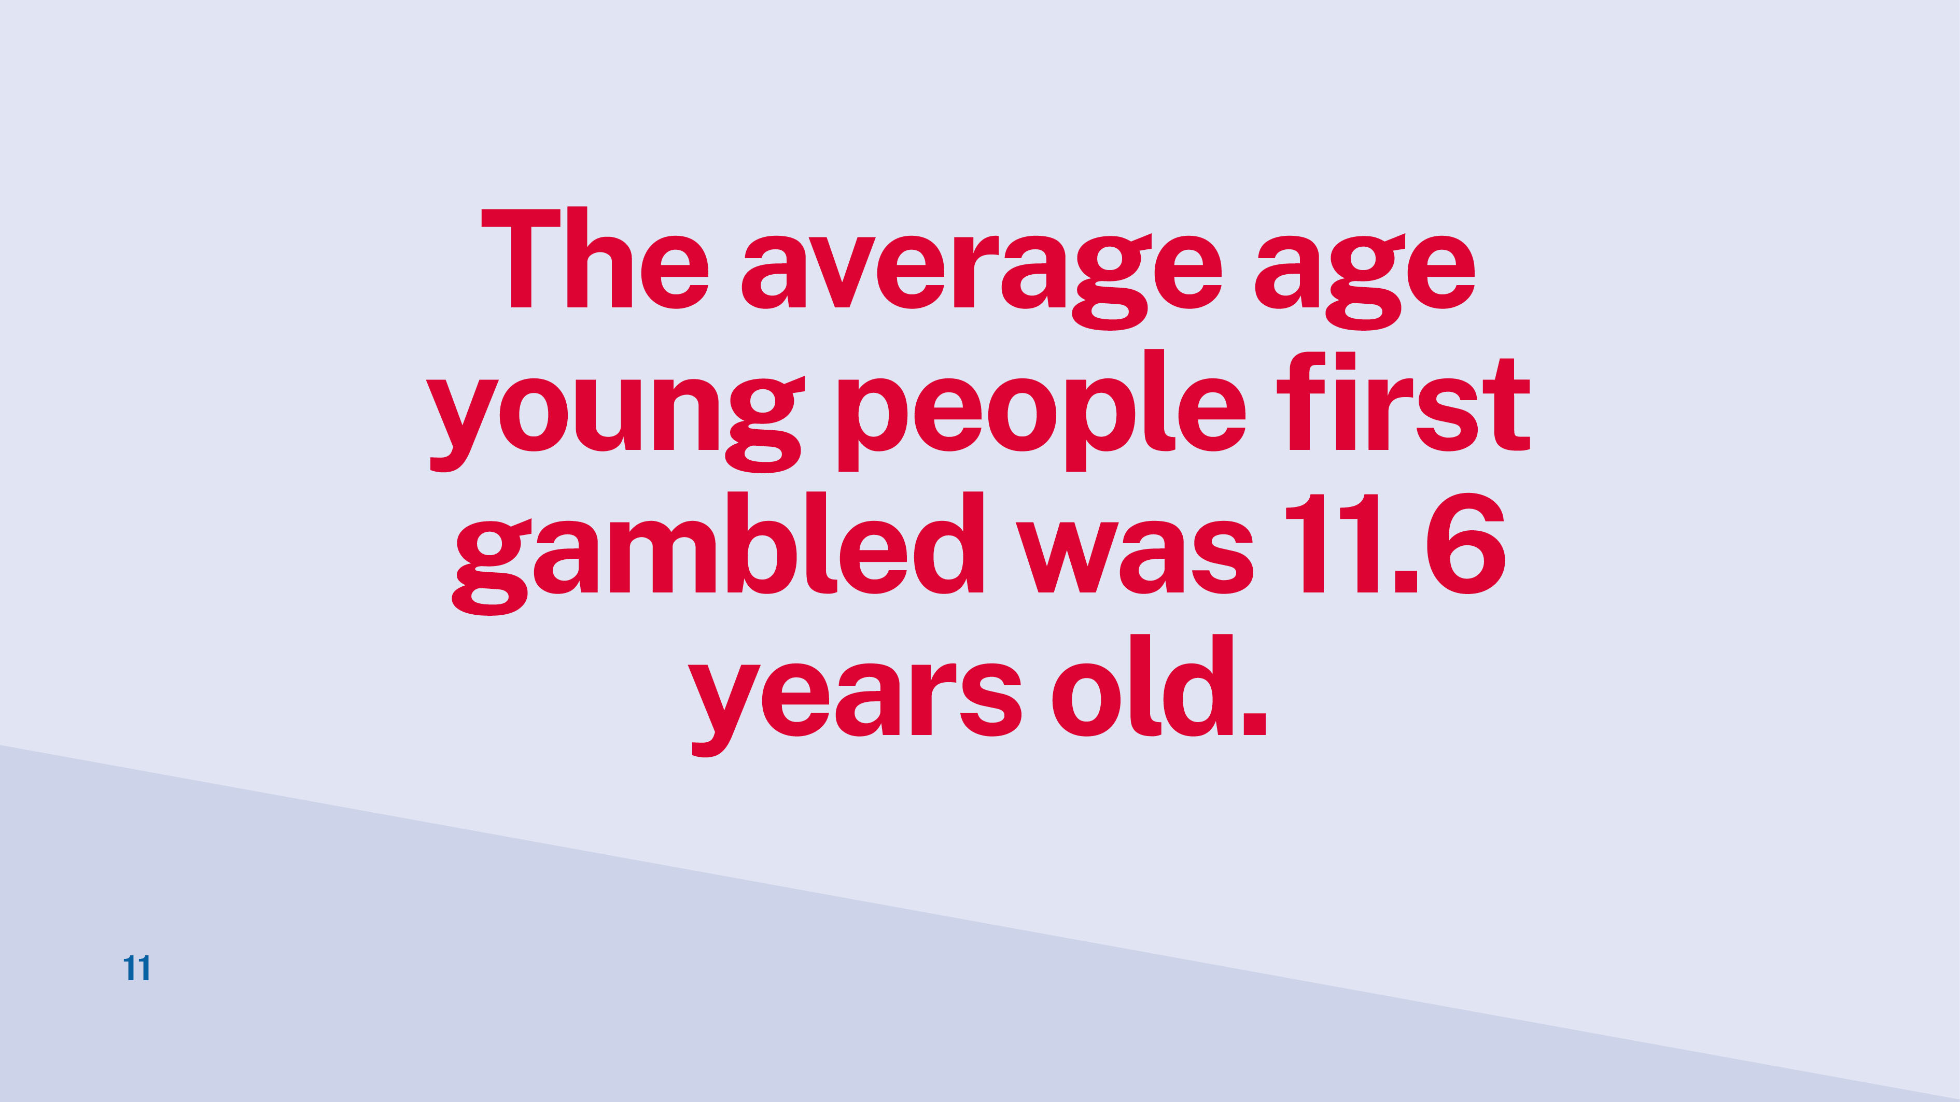
Notes:
Overall, the average age survey respondents reported they had first gambled on any gambling activity was 11.6 years.
Specific starting age for different gambling activities are:
5- 9 years for race betting
10-12 years for scratchies/lotteries, keno, and poker
13-15 years for all other forms of gambling.

Slide 12
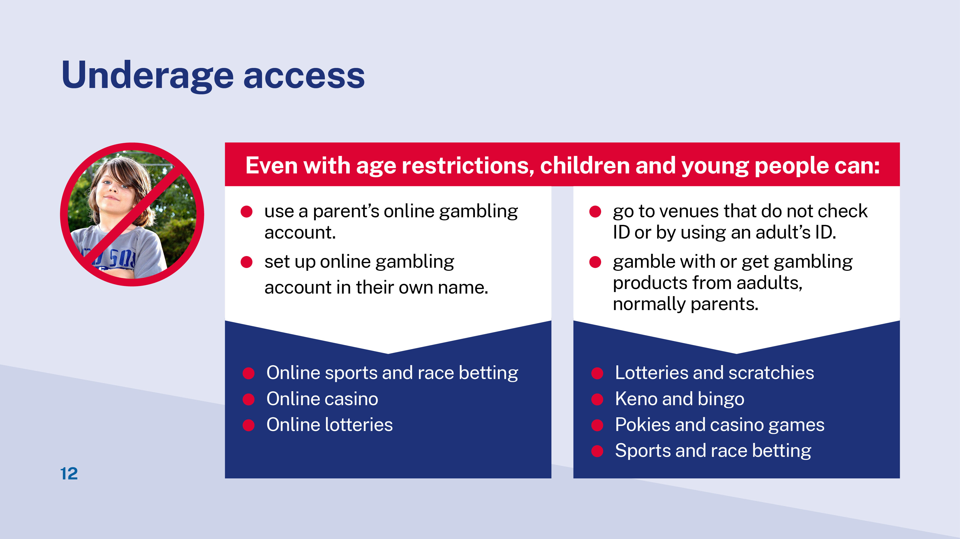
Notes:
Underage gambling is illegal in Australia. Age restrictions to commercial gambling activities apply to people under 18 years of age.
However, young people find they can sometimes get around the restrictions.
The table presents the most common ways young people access restricted gambling activities either online or in-person.
Highlight the fact that parents are most often funding and enabling these illegal activities. According to the Youth Gambling Survey 2020, about three quarters of the young people who had tried to participate in commercial gambling reported they had their parent’s permission.

Slide 13
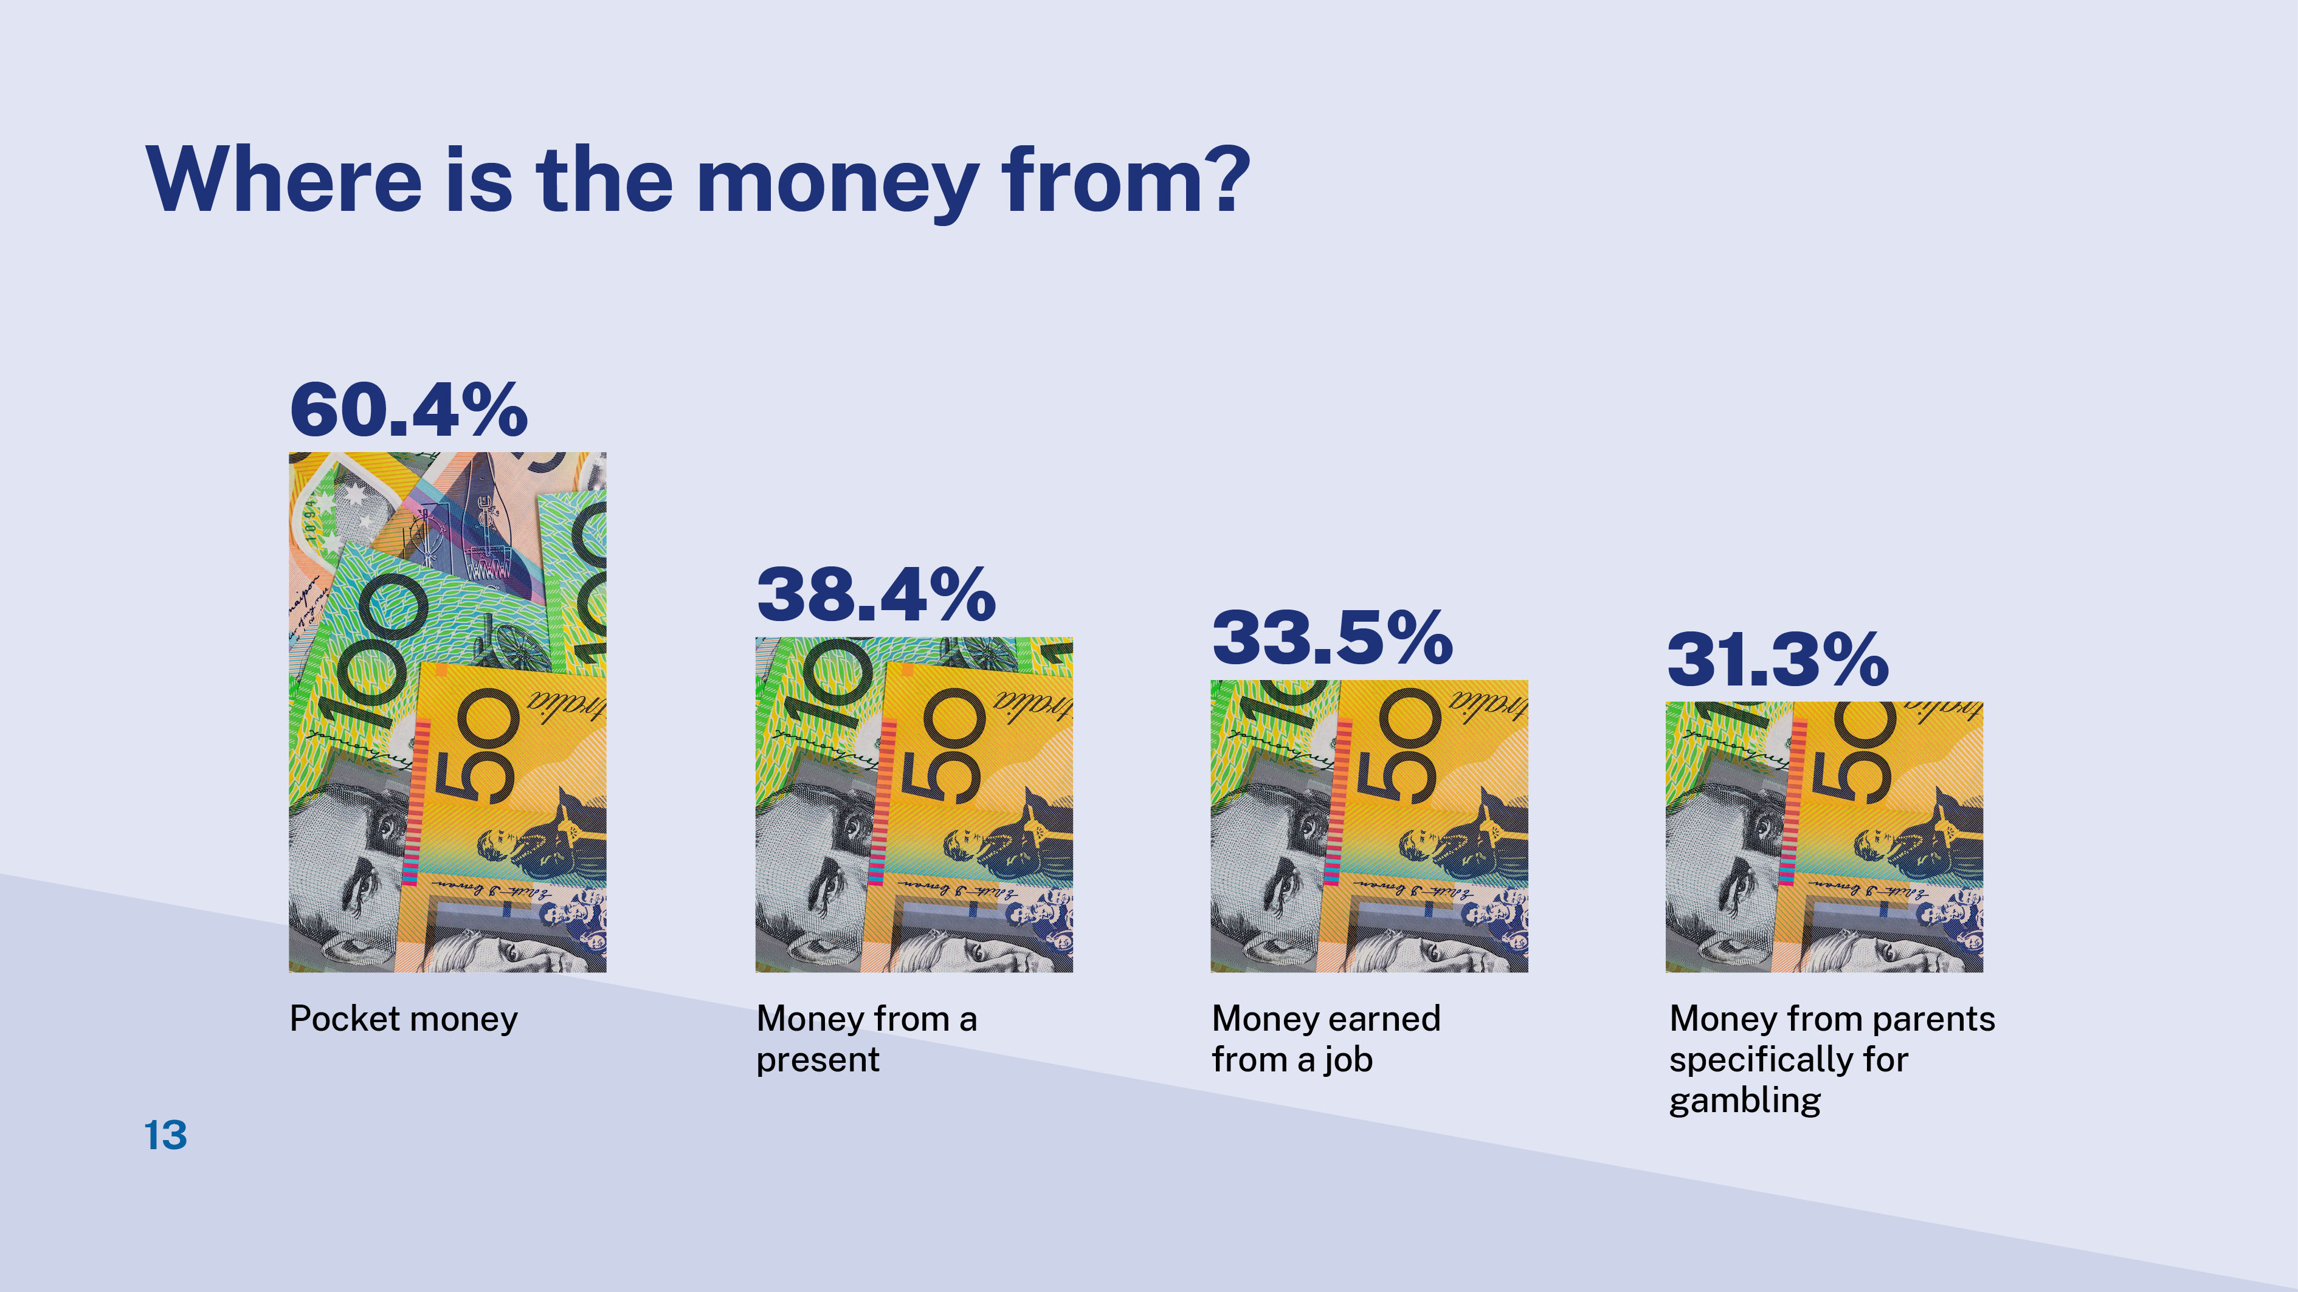
Notes:
Sources of money young people used for gambling include:
pocket money (60.4%) - most common source of money for gambling
money from a present (38.4%)
money earned from a job (33.5%)
money from parents specifically for gambling (31.3%) - an alarming fact is about one-third of young gamblers receive specific “gambling fund” from their parents.

Slide 14
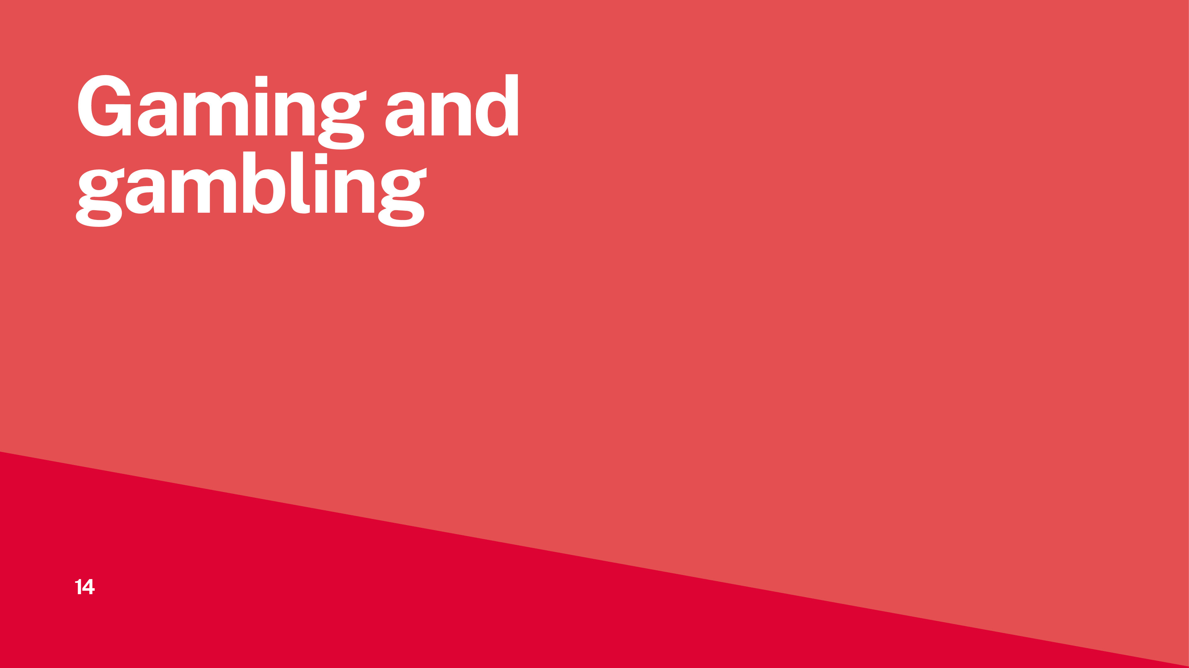
Notes:
The previous section introduces the concept of simulated gambling. This section digs a bit deeper into it.

Slide 15
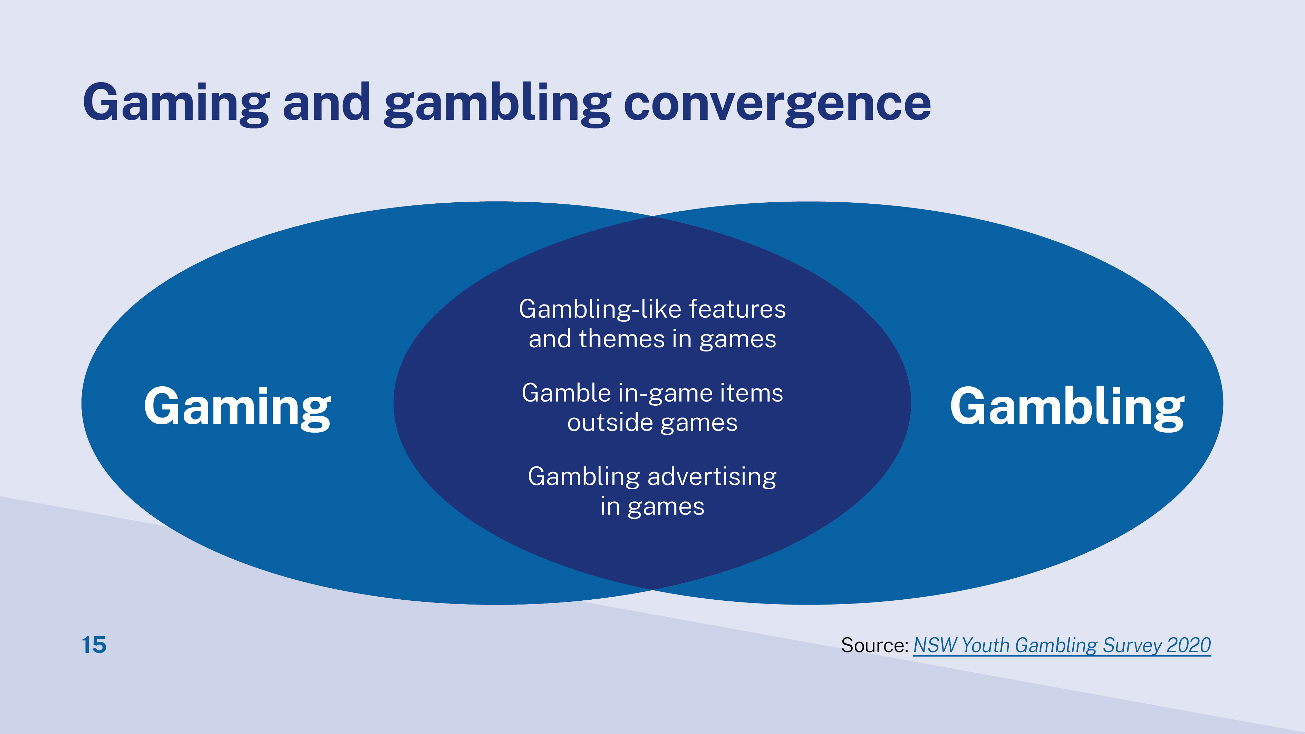
Notes:
On a high level, gaming and gambling are converging in three ways:
The line between gaming and gambling is blurry, there are many gambling-like features and themes in games.
Gambling products incorporate gaming themes and elements to engage better with young audience.
Many games replicate gambling products or have gambling like components.
Frequent engagement with gambling like components can be inevitable to progress in a game.
Players can gain advantages in games by purchasing loot boxes or virtual goods - using virtual credits.
Players can spend real money to buy virtual credits.
2. Gambling in-game items outside of games
In-game items can be used for betting on third-party websites.
In-game items can be currencies, weapons, tools, allies, character options and cosmetic changes (“skins”).
These virtual items can be earned through gameplay, but many video games allow players to purchase with virtual credits or real money.
The third-party websites are normally operated by overseas companies. Australian law and policy may not apply.
3. Gambling advertising in games
Gambling is promoted on competitive gaming events (also know as Esports).
Esports betting is promoted within many video games.
Gaming and gambling promotions are shared and accessible from the one device, including in online games, social media and esports events.
Gaming and gambling products are cross-promoted and have overlapping market.

Slide 16
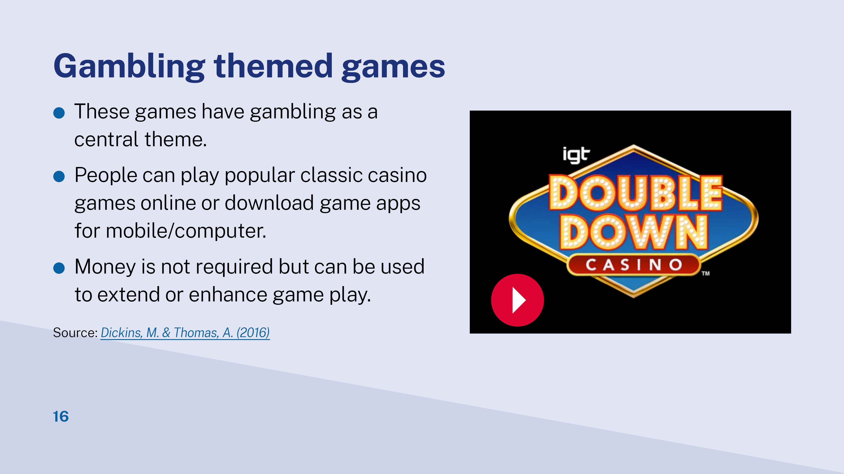
Notes:
Popular forms of simulated gambling 1 - Gambling- themed games
These games have gambling as a central theme. Money is not required but can be used to extend or enhance game play. You can play popular classic casino games like roulette, video poker, slots, and blackjack. In recent years, many commercial gambling companies have seen value in linking games to gambling and have begun investing in gambling themed games.
Play linked video to show DoubleDown Casino game ad: https://www.youtube.com/watch?v=YEdoie3UpZ0
Source: https://aifs.gov.au/agrc/publications/is-it-gambling-or-game#34

Slide 17
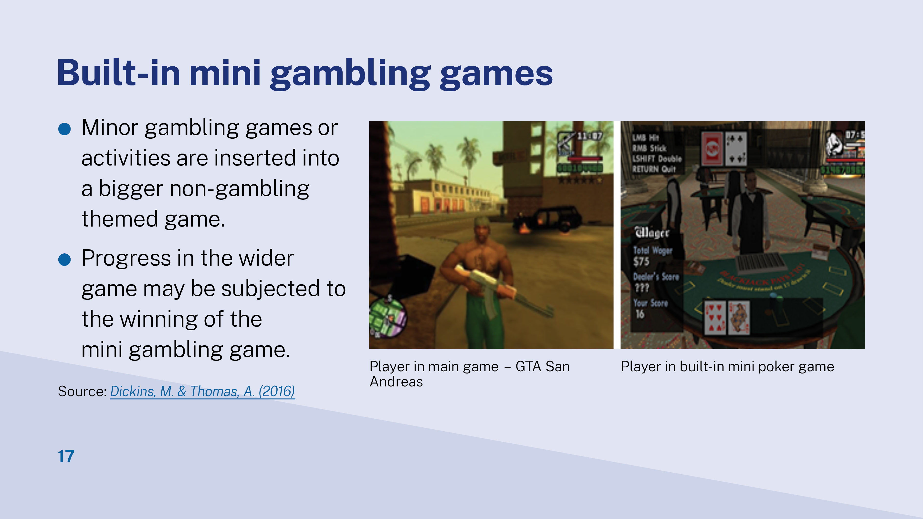
Notes:
Popular forms of simulated gambling 2 - Mini gambling games included within bigger non-gambling games
Minor gambling games or activities are inserted into a bigger non-gambling themed game. Progress in the wider game may be subjected to the winning of the mini gambling game.
The screenshot on the left shows the player in the main game of GTA San Andreas.
The screenshot on the right shows the player in a virtual gambling setting playing built-in mini gambling games.
Source: https://aifs.gov.au/agrc/publications/is-it-gambling-or-game#34

Slide 18
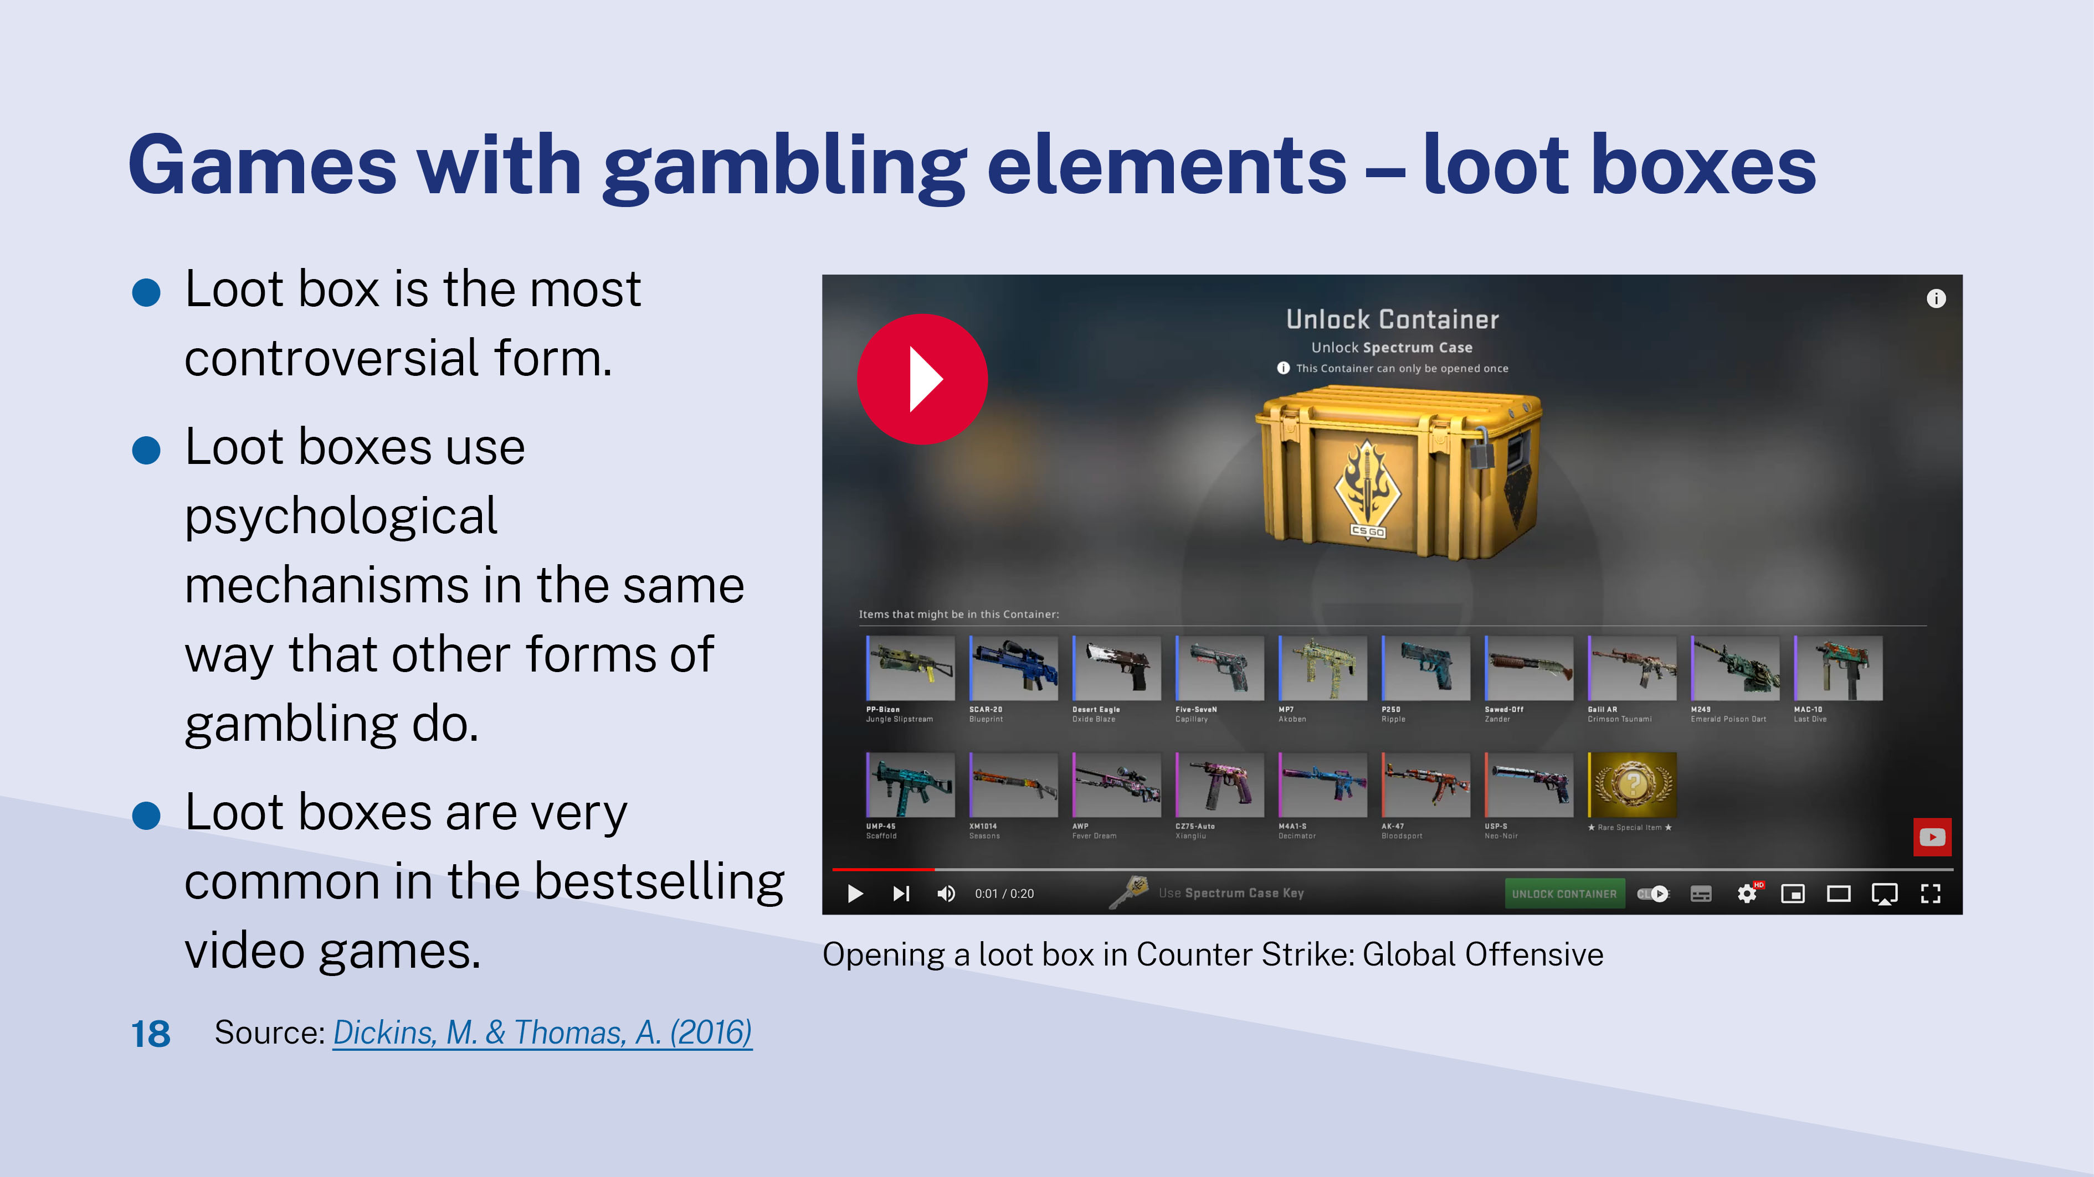
Notes:
Popular forms of simulated gambling 3 - Games with gambling associated elements (the most controversial form is loot boxes)
Loot boxes are features in video games. Players can access loot boxes through gameplay, or purchase with in-game items, virtual currencies, or directly with real-world money. They often appear as chests, crates, or card packs.
Loot boxes use psychological mechanisms in the same way that other forms of gambling do, such as:
random value – players don’t know what they are getting before purchasing loot boxes
variable ratio reinforcement – players don’t know when the next one is coming. They recast every fail of getting the desired value from loot boxes as a near win. This keeps players in the game longer and purchasing more
ready and constant availability.
Source: https://australiainstitute.org.au/wp-content/uploads/2020/12/P860-Risks-to-kids-from-video-games-Web.pdf
Loot boxes are common in the bestselling video games. Among the 82 bestselling video games, 62% (51) had loot boxes.
Loot boxes are a growing concern due to the risk and reward properties that closely align them with traditional gambling, the potential for encouraging greater gambling involvement, and the potential for associated gambling harm.
Source: https://www.gambleaware.nsw.gov.au/resources-and-education/check-out-our-research/grant-funded-research
The video shows the loot boxes in a popular video game Counter Strike: Global Offensive . Items may be in the loot box (the container) are weapons with different skins (the cover). Skins might worth different value to players, as well as in the third-party skin betting websites. Rarest skins were highly sought after and consequently attracted a higher price. Some skins are worth over $3,000.
Source: https://www.videogames.org.au/skin-betting
Link to video: https://www.youtube.com/watch?app=desktop&v=Em-lhJCbY4c

Slide 19
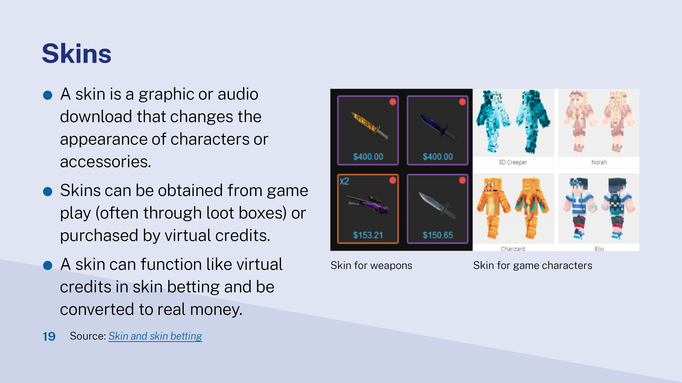
Notes:
A skin is a graphic or audio download that changes the appearance of characters in video games. They don't increase the character's abilities or impact the outcome of the game.
How does skin betting work?
Your child plays a game and purchases or wins some skins.
The skins are held in a virtual wallet.
The player takes their wallet to a different website.
This website offers gambling and betting games. *Many of these third party websites are operated by oversea business owners. This means they can avoid Australian regulation and laws.
The player bets/gambles using skins as their tokens.
The skins won can be traded for real money in some games.
Study shows gamers spent an equivalent of over $5 billion on Counter-Strike: Global Offensive skin gambling during 2016.

Slide 20
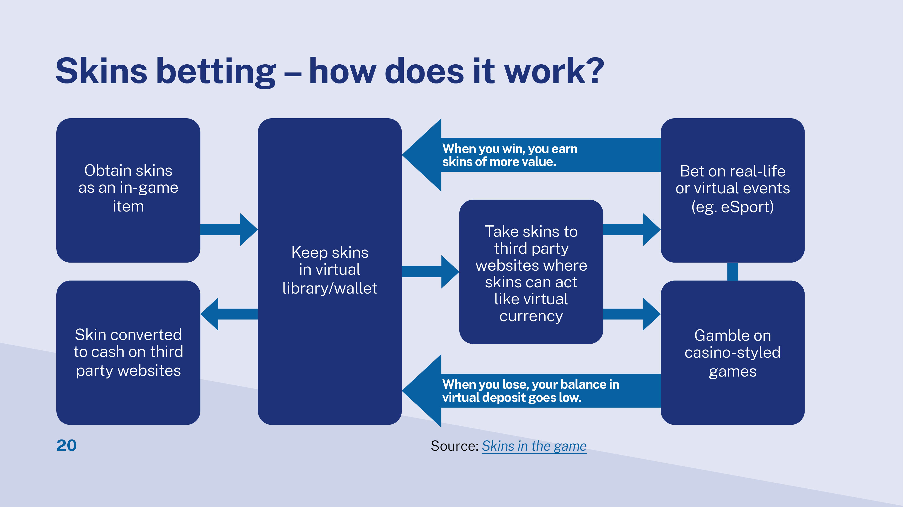
Notes:
How does skin betting work?
Your child plays a game and purchases or wins some skins.
The skins are held in a virtual wallet.
The player takes their wallet to a different website.
This website offers gambling and betting games. *Many of these third-party websites are operated by oversea business owners. This means they can escape from Australian regulation and laws.
The player bets/gambles using skins as their tokens or virtual currency
The skins won can be traded for real money in some games.
Study shows gamers spent an equivalent of over $5 billion on Counter-Strike: Global Offensive skin gambling during 2016.
Source: https://www.gambleaware.nsw.gov.au/resources-and-education/check-out-our-research/grant-funded-research

Slide 21
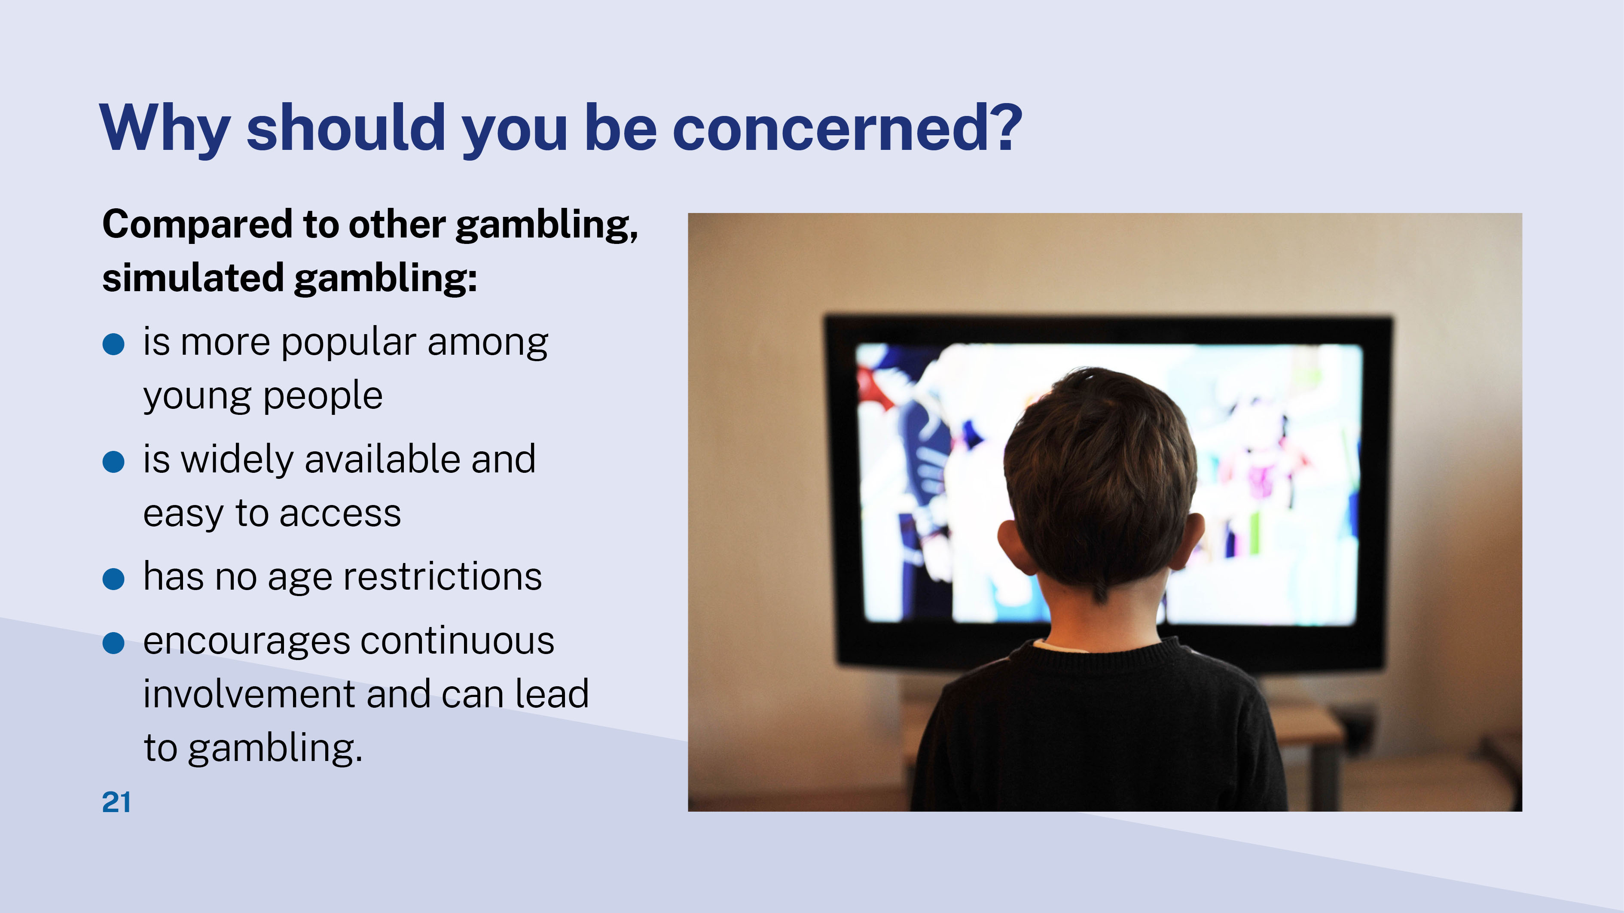
Notes:
Explain listed concerns from researchers:
Simulated gambling is more common than monetary gambling among young people- 40.1% vs 29.8% (this is mentioned earlier).
Simulated gambling is more accessible and no age restrictions – most young people have at least one device dedicated for their use.
It will increase the chance to continue to gamble and risk to gambling harm in adulthood.
Children may not spend money and gamble in traditional ways, but they learn how chance works and get to experience the thrill of the win.
encourages continuous involvement and facilitates transit to gambling in adulthood.

Slide 22
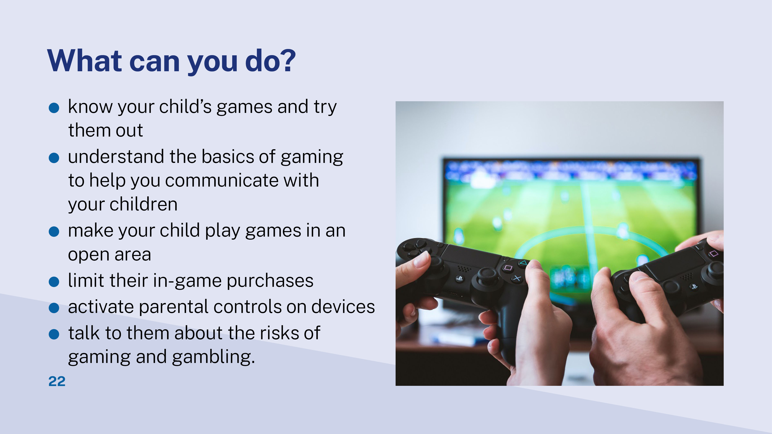
Notes:
Read out the advice listed on the slide.
Discuss whether they are practical for participants. What might be some barriers and facilitators to implementing these?
Let participants contribute other ideas if any.

Slide 23
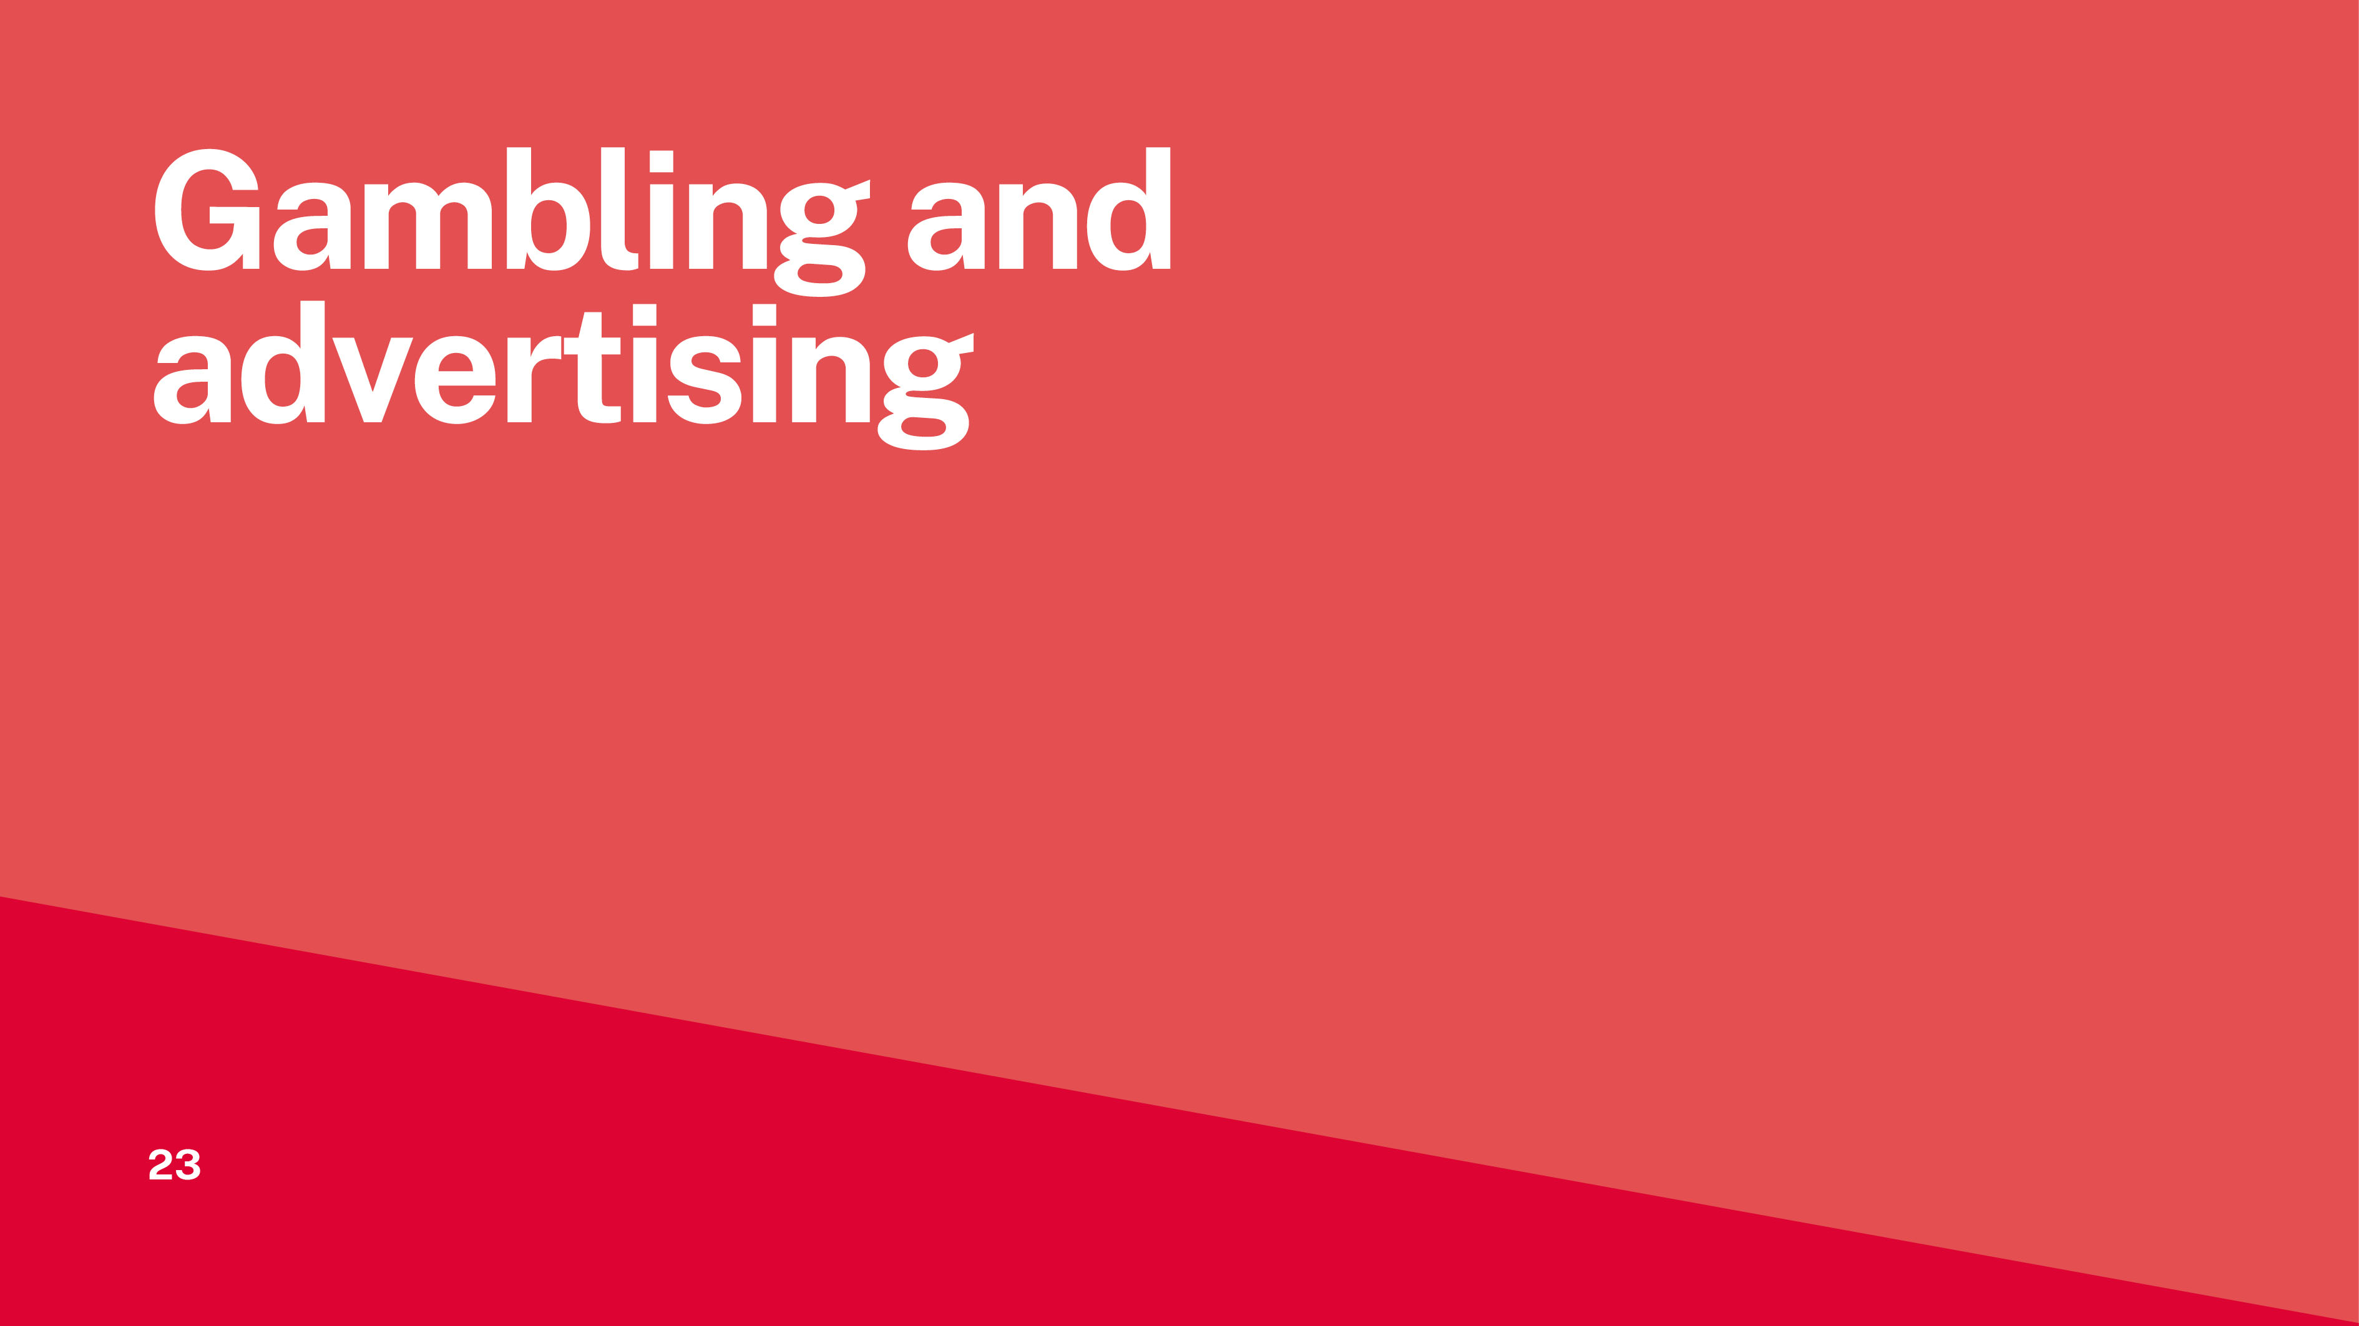
Notes:
There are a few factors influencing young people’s gambling attitudes and behaviour:
personal factors: age, gender, social wellbeing, personality
peers
access to internet
parents/guardians: attitudes and own gambling behaviours
gambling advertising.
This workshop session focuses on two of the influential factors: gambling advertising and parents.

Slide 24
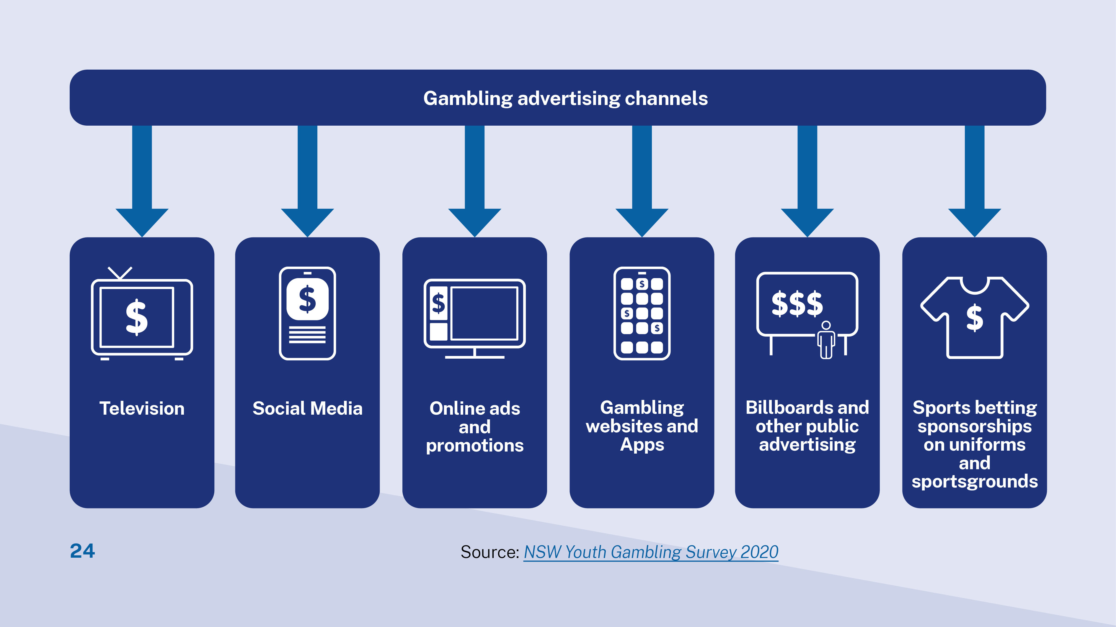

Slide 25
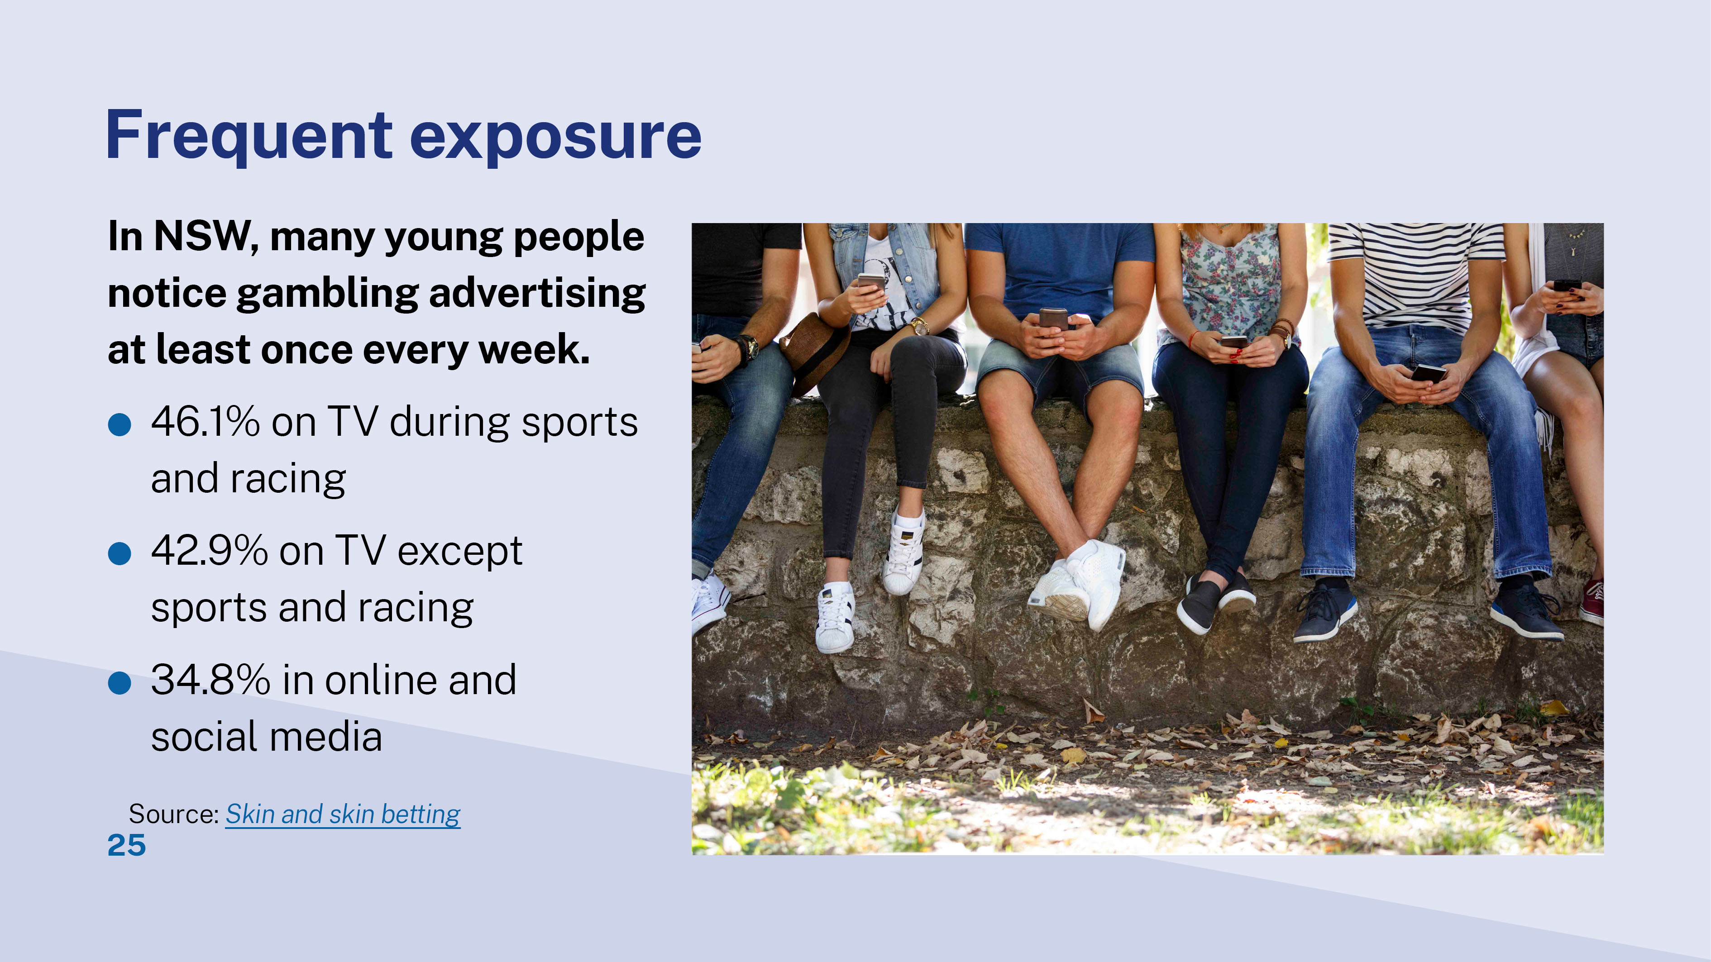

Slide 26
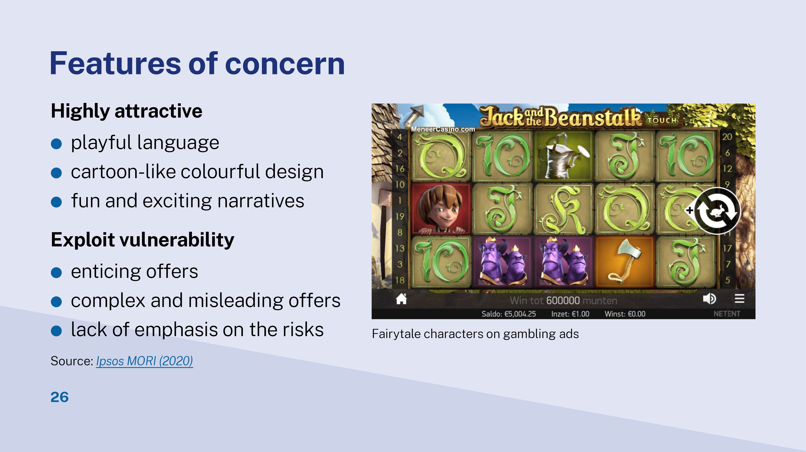
Notes:
Some gambling advertisements features are specifically attractive young people.
playful language (e.g. ‘Starburst’, ‘House Party’)
cartoon-like colourful graphic design
fun and exciting narratives.
The contents of gambling advertisement also exploits the vulnerability of young people.
enticing offers (e.g. free bets or spins, money back guarantees)
overly complex and misleading presentation of offers
lack of emphasis on the risks of gambling.
Young people, particularly those under 16 years of age, do not fully understand how odds work. They usually have confusion about chances of winning and underestimate the risk. Unless children actually experienced discrepancies between products as advertised and as consumed, they were unable to entirely comprehend advertising’s persuasive intent.
For example, if children have not experienced losses from sports wagering, they are unlikely to understand the intent behind the highly positive social and financial messages about sports wagering. ^{[9]}
Picture source from https://www.campaignlive.co.uk/article/cap-bulks-guidance-gambling-ads/1525629

Slide 27
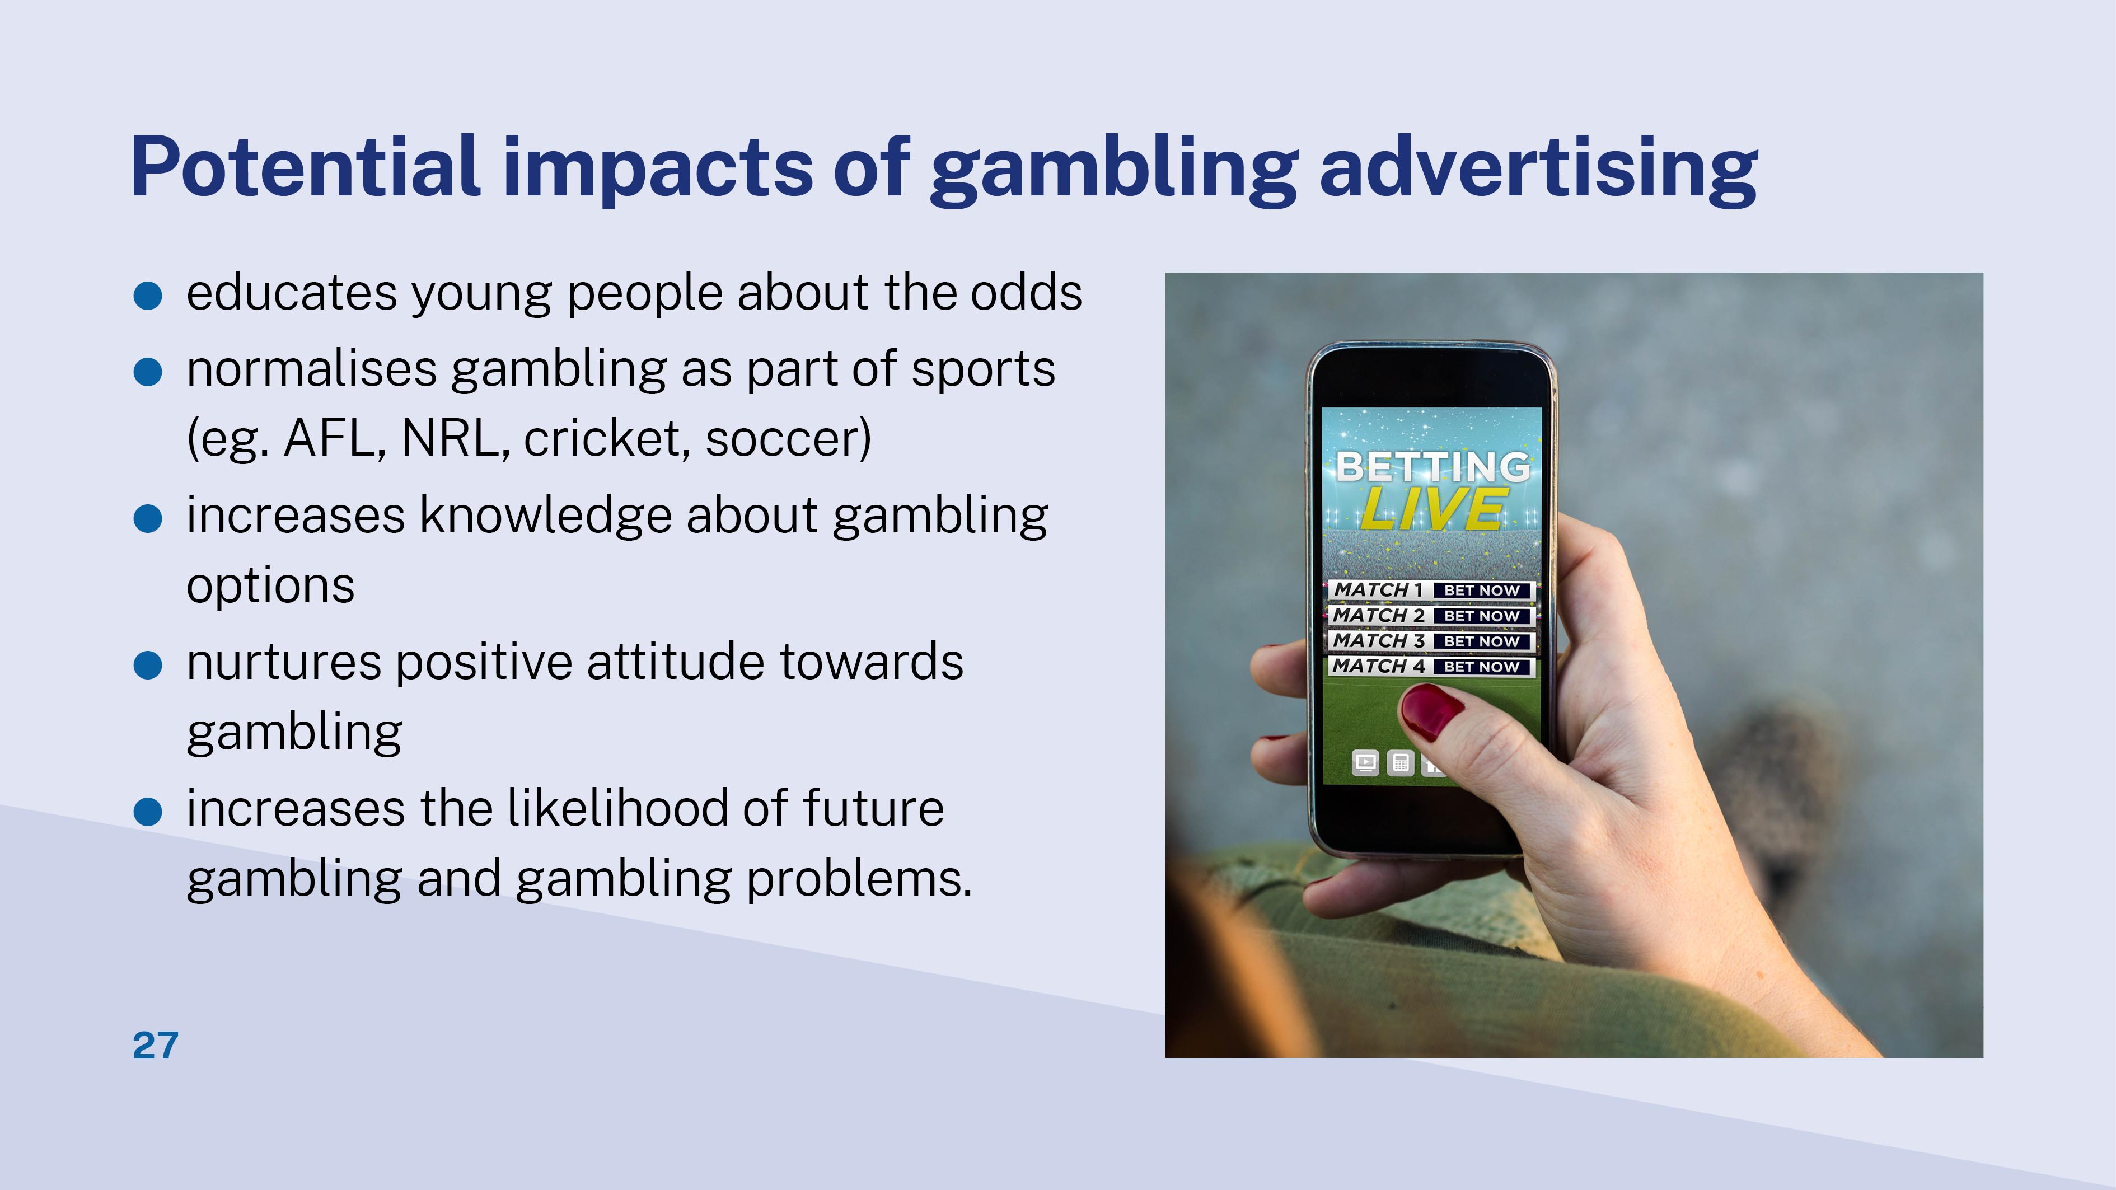
Notes:
Gambling advertising might make young people feel:
betting is normal part of sport events
positive about all gambling activities (e.g. your child might think that winning a big lottery jackpot is common, or that his/her peers will think they are cool if he/she gambles)
know more about gambling options – there are more ways you can do it, by yourself! More than just putting a bet with your parents.
Together, gambling advertising may lead to increased participation and higher risk of problem gambling behaviours from adolescent to adulthood.
Reclaim the Game initiative
The NSW Gambling Survey 2019 found that one in 20 adults bet on sports. With smartphones and online accounts, sports betting is now at everyone’s fingertips, 24/7. Over $270 million was spent on gambling advertising in Australia in 2018. Sports-betting promotion is ever present in sport – through TV ads, in-stadium signage, sponsorship deals and online promotion.
The Office of Responsible Gambling launched Reclaim the Game initiative in 2020. The aim to address the normalisation of sports betting and raise awareness of gambling harm.
The Office partners with big sporting teams in this initiative. These teams will not accept any sports betting sponsorship or promotional agreements. Supporters and local communities can enjoy sports without betting, and staff, players and fans can be educated about gambling risks.
Our partnership teams are cross a range of sports coding, including AFL, cricket, basketball, football and NRL.

Slide 28
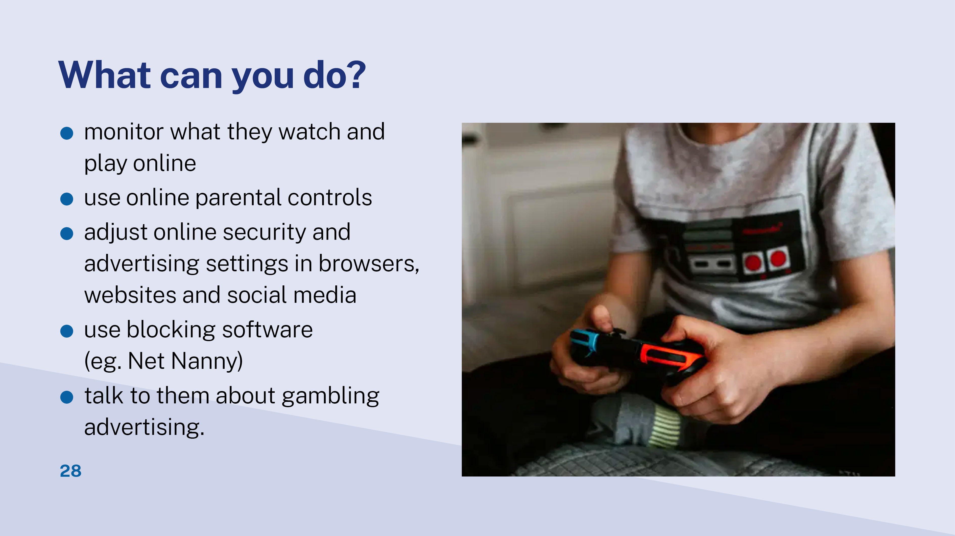
Notes:
Adjust online security and advertising settings:
You have control over online security and advertising settings in the browser, social media and websites that you use. For example, you can block gambling advertisers in your Google Chrome browser by following these simple steps:
Go to settings or click on manage your Google account.
In the left column, locate data and personalisation and select it.
Scroll down and look for ad personalisation
Click on it and slide it off.
You can also download Adblock Plus or similar extensions and configure them to work on your browser or phone apps.
If you use Facebook, you can adjust your ads preferences to limit gambling advertising:
Click on the down arrow in the top right of any Facebook page and click Settings.
Click Ads in the left sidebar.
From your Ad Preferences page, you can update your interests, choose what Facebook information is used to show you ads and adjust your general ad settings.
Online blocking software
Blocking software is designed to stop you from accessing certain websites. There are two types available:
General blocking software is designed to set access authorisations or parental controls to prevent access to a range of sites.
Gambling-specific blocking software blocks gambling websites.
Net Nanny is a general blocking software that can monitor and block internet content in various categories, including gambling. It can also track search engine usage, enforce safe search and receive warnings for flagged words (e.g. poker, casino). Net Nanny can also be used to place daily time limits on device use.
There is also blocking software available just for gambling. These include:
Gamban (Android, Windows, Mac OS X, and iOS)
Gamblock (Android Phones and Windows PCs)
Bet Filter (Android, Windows, iOS, and Mac)
Bet Blocker (Linux, Windows, and Mac)
How to talk to them about gambling advertising
Ask them what they think
Grab opportunities as they come up: It doesn’t have to be a lecture. Just show your child you’re open, and they can talk to you about gambling at any time. Maybe chat in the car on the way to school or sport practice, or when a gambling ad pops up on TV, or if you notice there are loot boxes in a video game they’re playing.
Cover the important topics:
Make sure your child knows there’s a lot to love about competitive sport, and you don’t need to have a bet, or know the odds, to make it fun and exciting.
Help your child understand the odds are always in the favour of gambling providers.
Questions like “Do you know the odds of winning on the pokies?” or “Do you know how much money is spent on sports betting advertising?” can be great conversation starters.
*You can also ask parents what, if anything, they have tried and what has/hasn't worked. This will make the participants feel more engaged and they can learn from each other.

Slide 29

Notes:
Parent/Guardian is the MOST influential factor to young people's gambling attitude and behaviour.

Slide 30
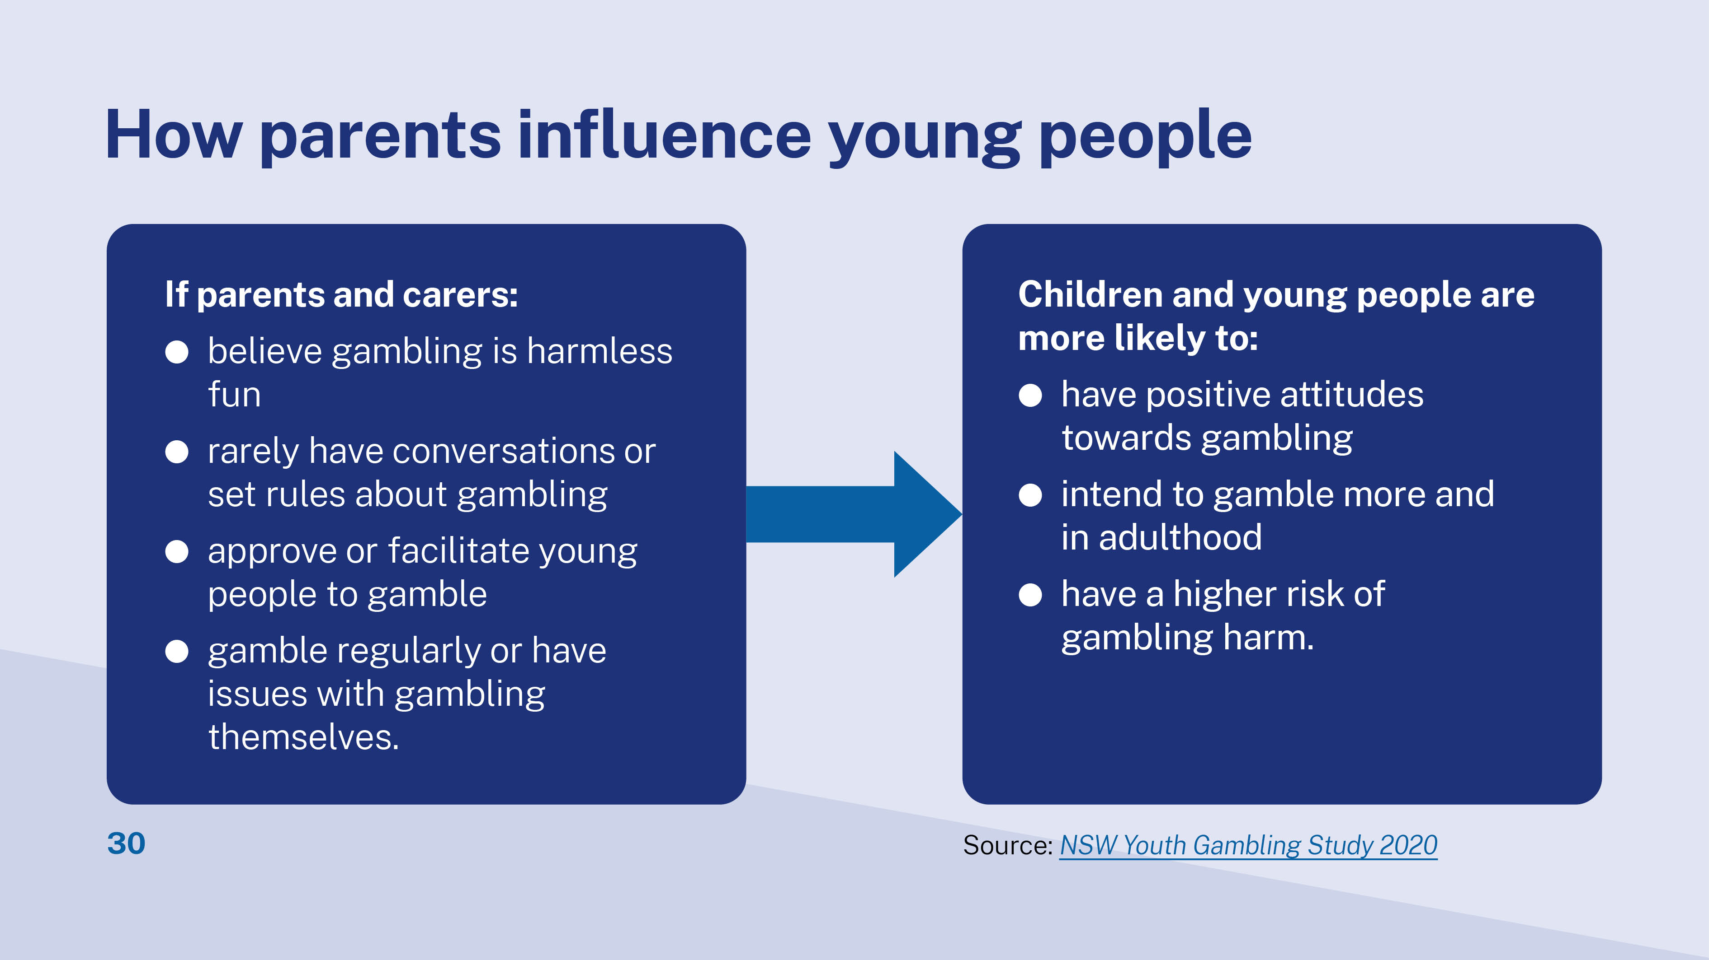
Notes:
This chart shows how certain parental attitudes and behaviours can affect young people.
How do some parents influence?
Some parents believe that gambling is harmless fun.
Parents are far less likely to talk to their children about problem gambling than other risky behaviours (e.g. alcohol and drug misuse or safe sex)
Some parents assist their children to access age restricted commercial gambling activities
Examples are:
1. Permit your young person to use your betting account.
2. Place a bet on a sport/Melbourne Cup for a child under 18.
3. Let children pick the numbers for a lotto ticket.
4. Give children scratchies/lotto tickets for birthdays.
Some parents have gambling problems. Growing up with a problem gambling adult is a unique predictor for problem gambling in young people.
Source: https://www.theguardian.com/society/2020/mar/27/children-more-likely-to-become-gamblers-due-to-high-volume-of-betting-ads
Impacts on young people include:
form positive attitudes towards gambling
participate in gambling more
continuous gambling in adulthood
increased risk of experiencing gambling harm.

Slide 31
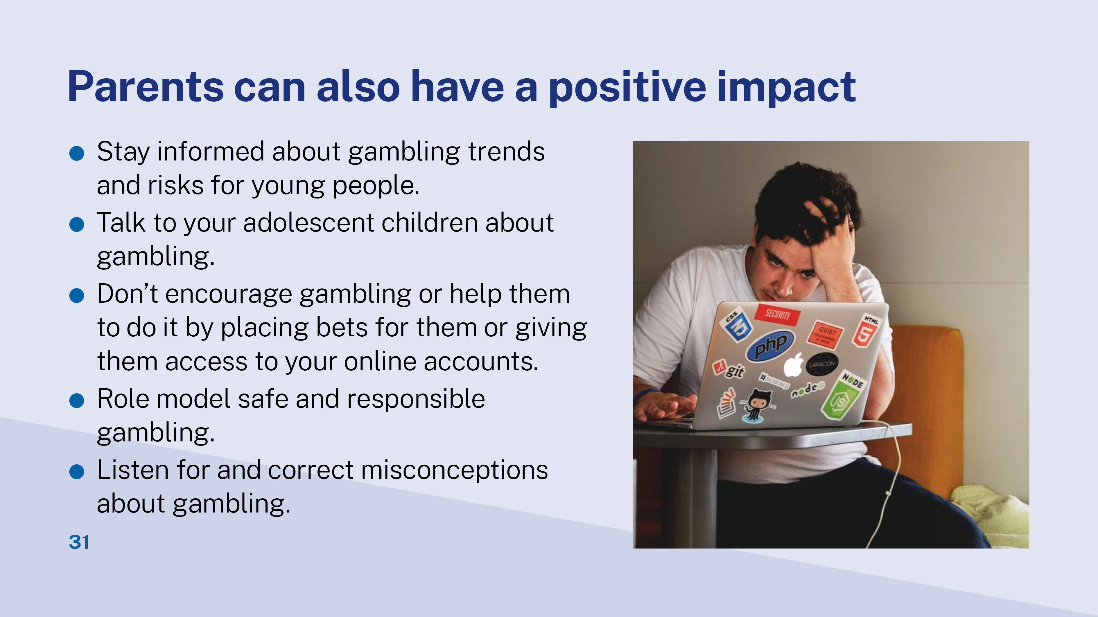
Notes:
Safe and responsible gambling:
Set and stick with limits
Have a game plan
Keep head clear
Ignore peer pressure
Get balance in life
More tips on safe gambling here: https://www.gambleaware.nsw.gov.au/learn-about-gambling/gamble-more-safely
Common misconceptions about gambling:
Myth: Gambling is a good way to make money
Fact: Gambling should be understood as a form of entertainment
Myth: Using special techniques/strategies will help you win the lottery
Fact: Outcomes in games of chance are random
Myth: The longer you gamble on a machine the more likely you'll win a big prize
Fact: Each spin on a gaming machine is independent of previous spins
Myth: "If I keep betting my luck will change, and I can win back the money I've lost."
Fact: Feeling that it's time you had a win, or even needing a win, will not change your odds of winning
Source: https://austgamingcouncil.org.au/responsible-gambling/understanding-responsible-gambling/gambling-myths-facts

Slide 32
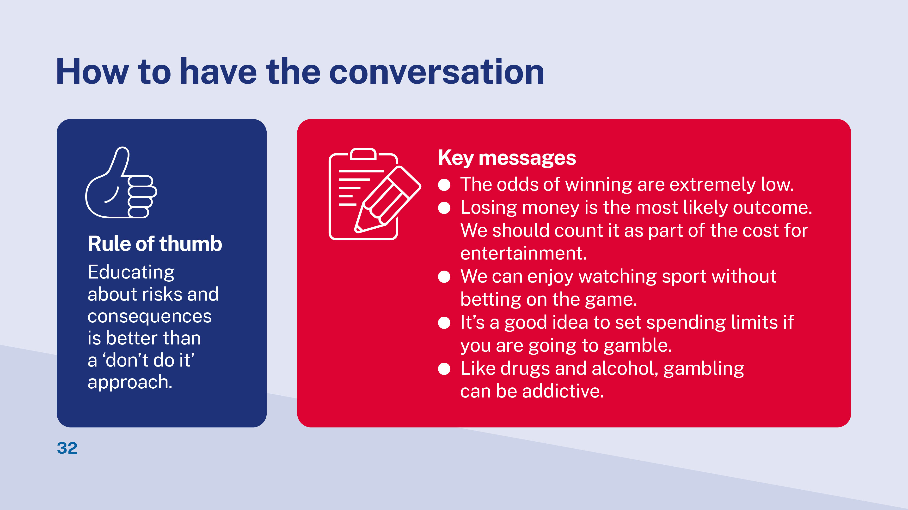
Notes:
By having these conversations you can help them to stay aware of the dangers of problem gambling. As they get older it will help them understand the difference between gambling on occasion and excessive gambling that can negatively impact other areas of their life.
Start the conversation by asking your young person what they know about gambling etc…. Listen to their concerns……

Slide 33
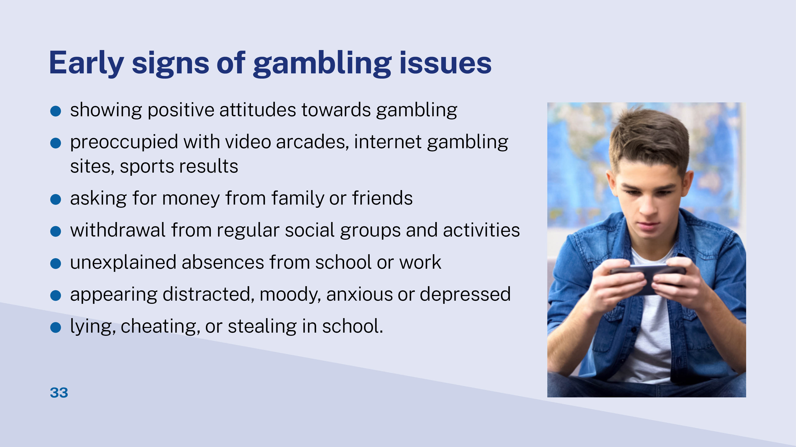
Notes:
Full list of signs can be found: https://www.gambleaware.nsw.gov.au/supporting-someone/supporting-young-people/signs-gambling-may-be-a-problem-young-people

Slide 34


Slide 35
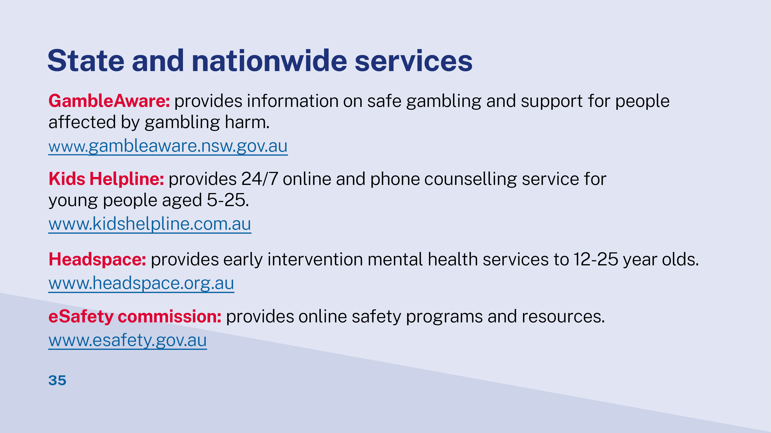
Notes:
GambleAware is the brand name for the NSW Office of Responsible gambling and the programs and services it manages. It is fund by Responsible Gambling Fund (RGF) to encourage responsible gambling, reduce harm caused by gambling, and help address and prevent gambling-related issues. You can get more information on supporting young people section on the website https://www.gambleaware.nsw.gov.au/supporting-someone/supporting-young-people
Kids Helpline is a free, confidential 24/7 online and phone counselling service for young people aged 5 to 25. Qualified counsellors are available via WebChat, phone or email anytime and for any reason.
Headspace is the National Youth Mental Health Foundation providing early intervention mental health services to 12-25 year olds. They help young people with mental health, physical health (including sexual health), work and study support.
eSafety commissioner is an independent statutory office supported by the Australian government. It provides a wide range of online safety programs and resources.

Slide 36
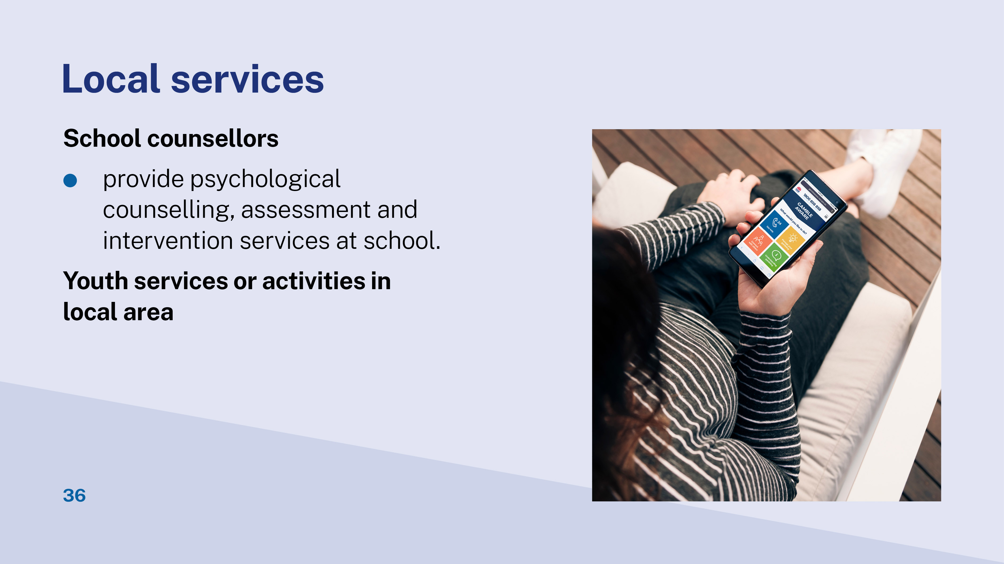
Please give examples of local youth services and activities in your GambleAware service area.
Notes:
*Please enter your examples of local youth services and activities in the editable text box

Slide 37

Notes:
Disseminate the Take home message cards and Workshop evaluation surveys.

Slide 38
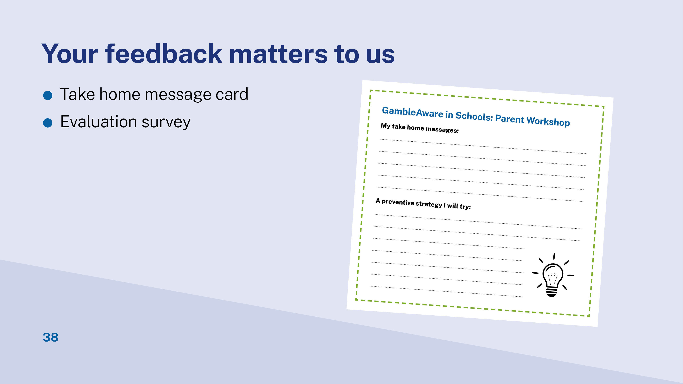

Slide 39
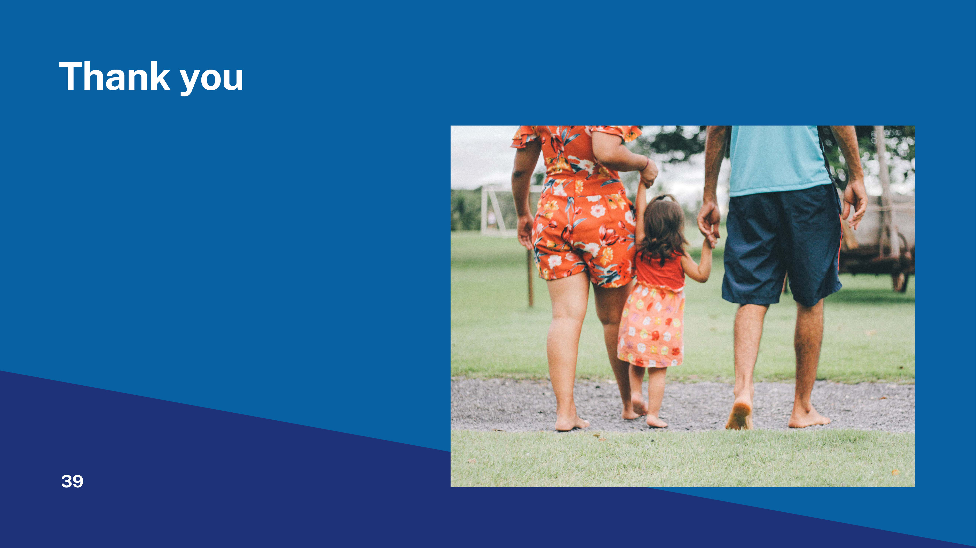
Contact details
Name:
Email:
Phone:
Notes:
* Please update your contact details in the editable text box. This is optional.

